Slide 1
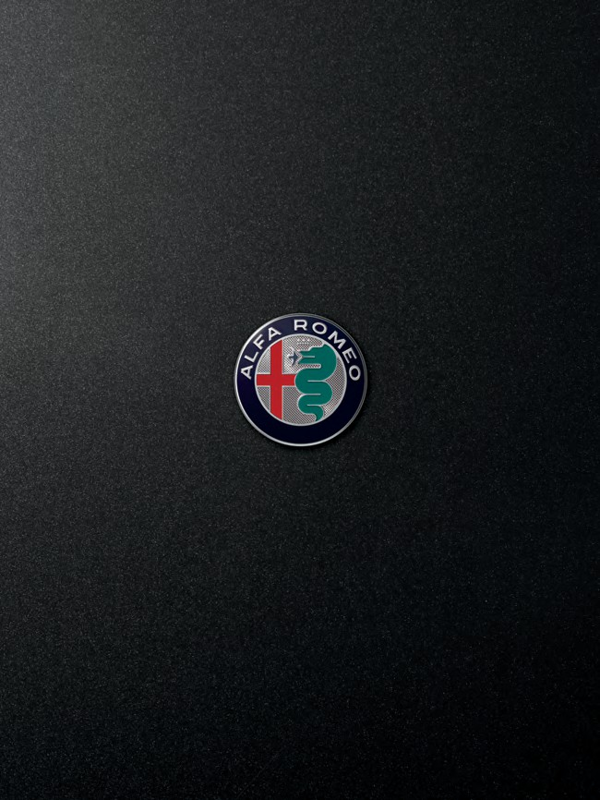
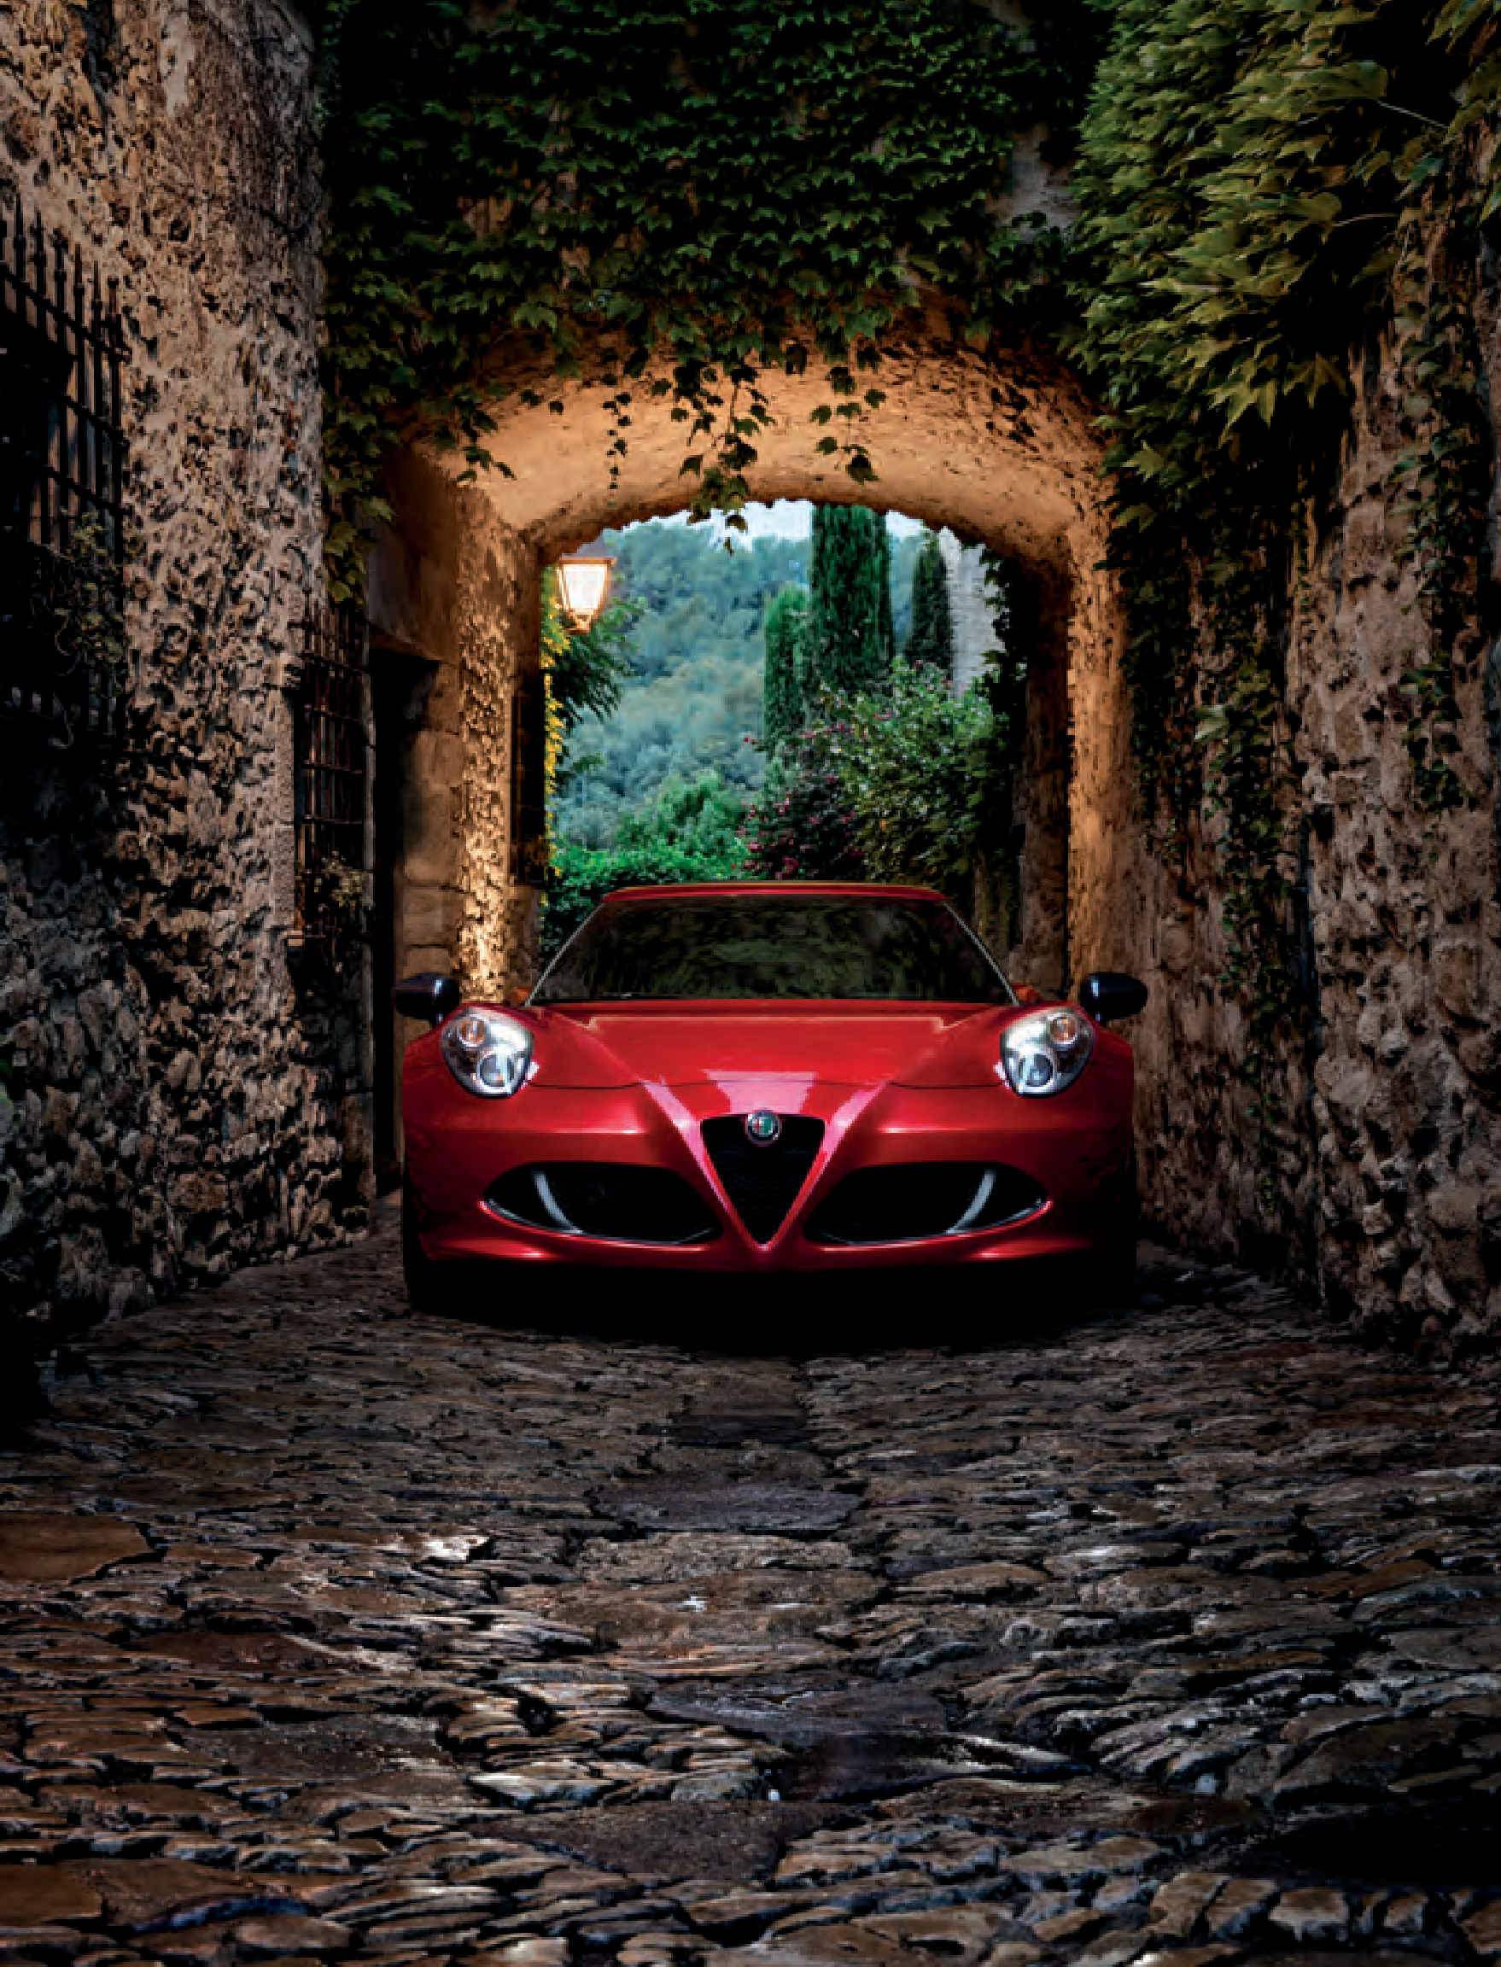




ALFAROMEOUSA.COM
1.844. ALFAUSA
Alfa Romeo is a registered trademark of FCA Group Marketing S.p.A., used with permission.

Slide 2
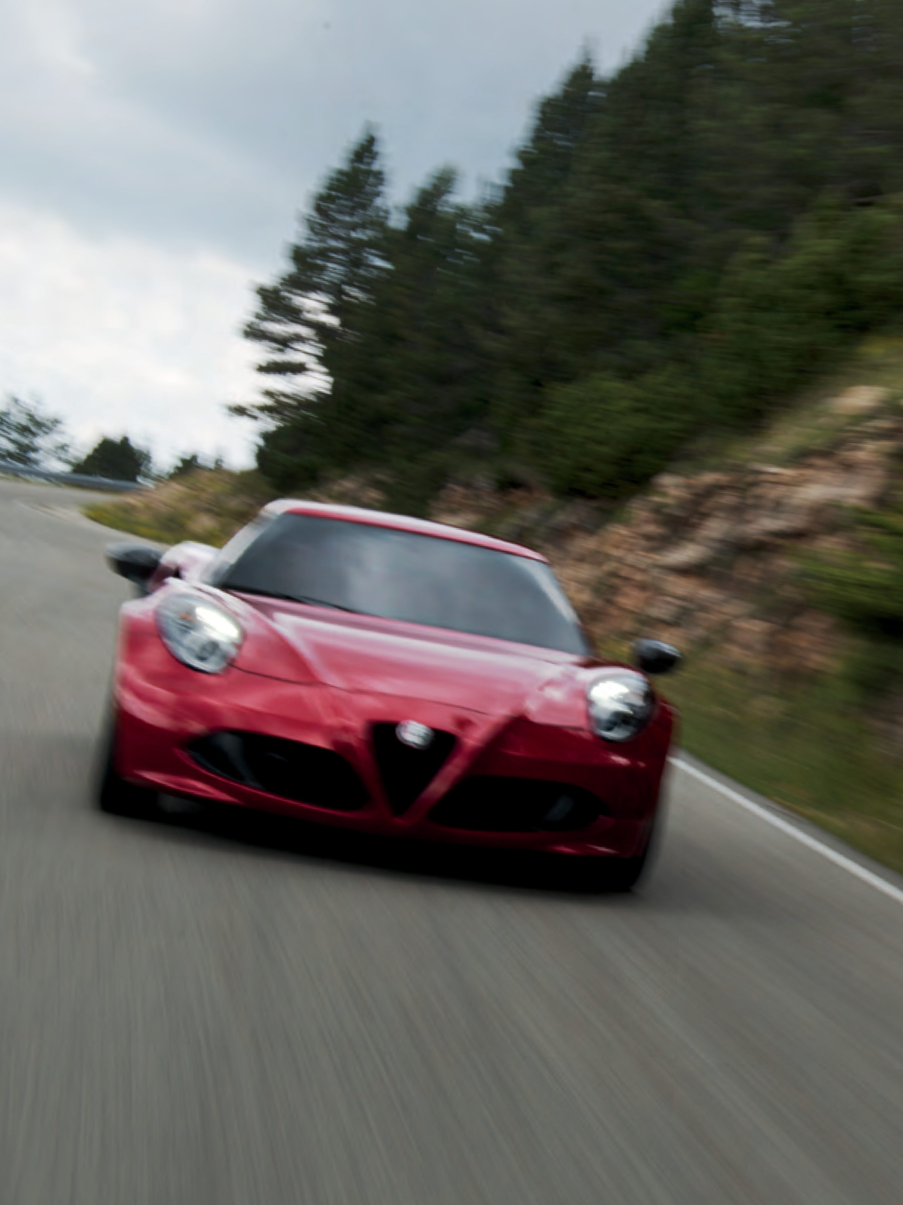
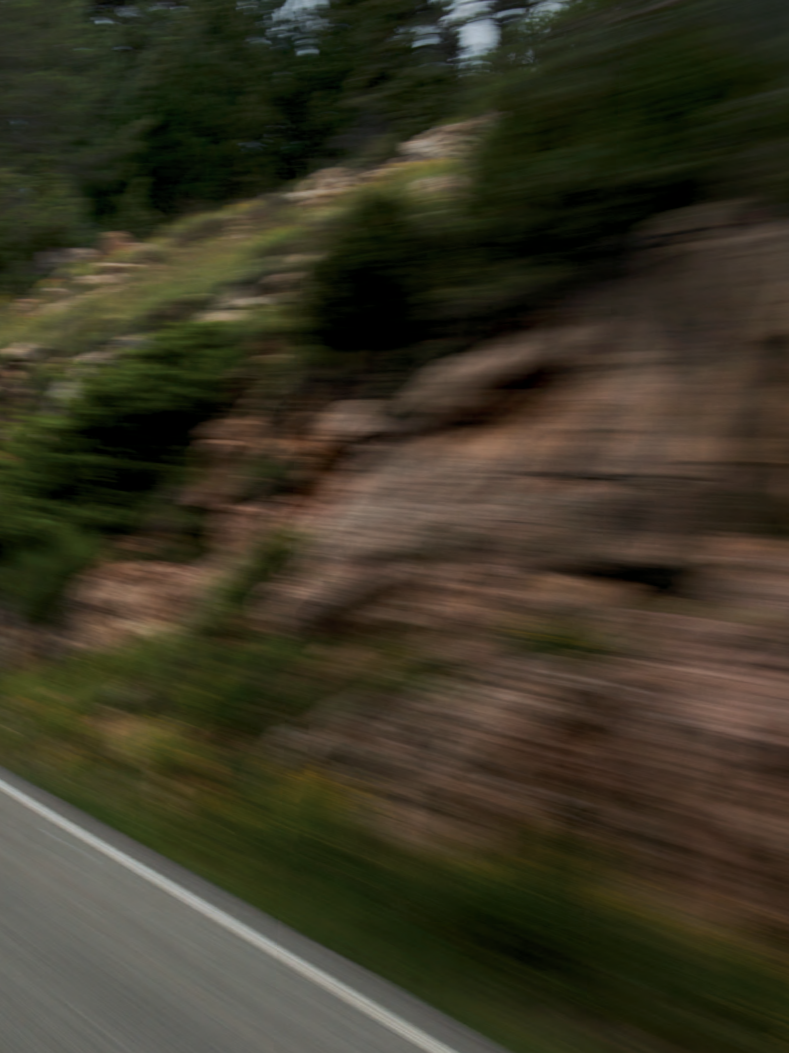

IT HAS EARNED ITS PLACE AS ONE OF AUTOMOTIVE’S MOST REVERED NAMES FOR MORE THAN A CENTURY. THE ALFA ROMEO TRADITION WAS BORN FROM INNOVATIVE TECHNOLOGY, RACE-INSPIRED PERFORMANCE AND SEDUCTIVE ITALIAN DESIGN. FUELED BY PASSION, DARING INVENTION AND PROVEN TRACK RECORDS, ALFA ROMEO CONTINUES ITS EVOLUTIONARY JOURNEY.
WHAT TRULY SETS ALFA ROMEO APART IS A UNIQUE UNDERSTANDING OF HOW EMOTION DRIVES US. IT’S HOW OUR DESIGNERS AND ENGINEERS PRODUCE VEHICLES LIKE NOTHING YOU HAVE EVER SEEN, FELT OR HEARD. VEHICLES THAT PROVIDE A TRULY PERSONAL CONNECTION WITH THE ROAD. FOR THE PURE DRIVER IN YOU, BEHOLD THE ALFA ROMEO 4C COUPE AND 4C SPIDER.
2
CONTENTS
| INTRODUCTION 2
HISTORY 6
4C COUPE 8
4C SPIDER 14
TECHNOLOGY 20
PERFORMANCE 24
STYLING 36
COLOR PALETTE 40
INTERIOR OPTIONS 42
WHEEL OPTIONS 44
4C FEATURES AND OPTIONS 46
MERCHANDISE 52
SOCIAL MEDIA 54
|
3

Slide 3
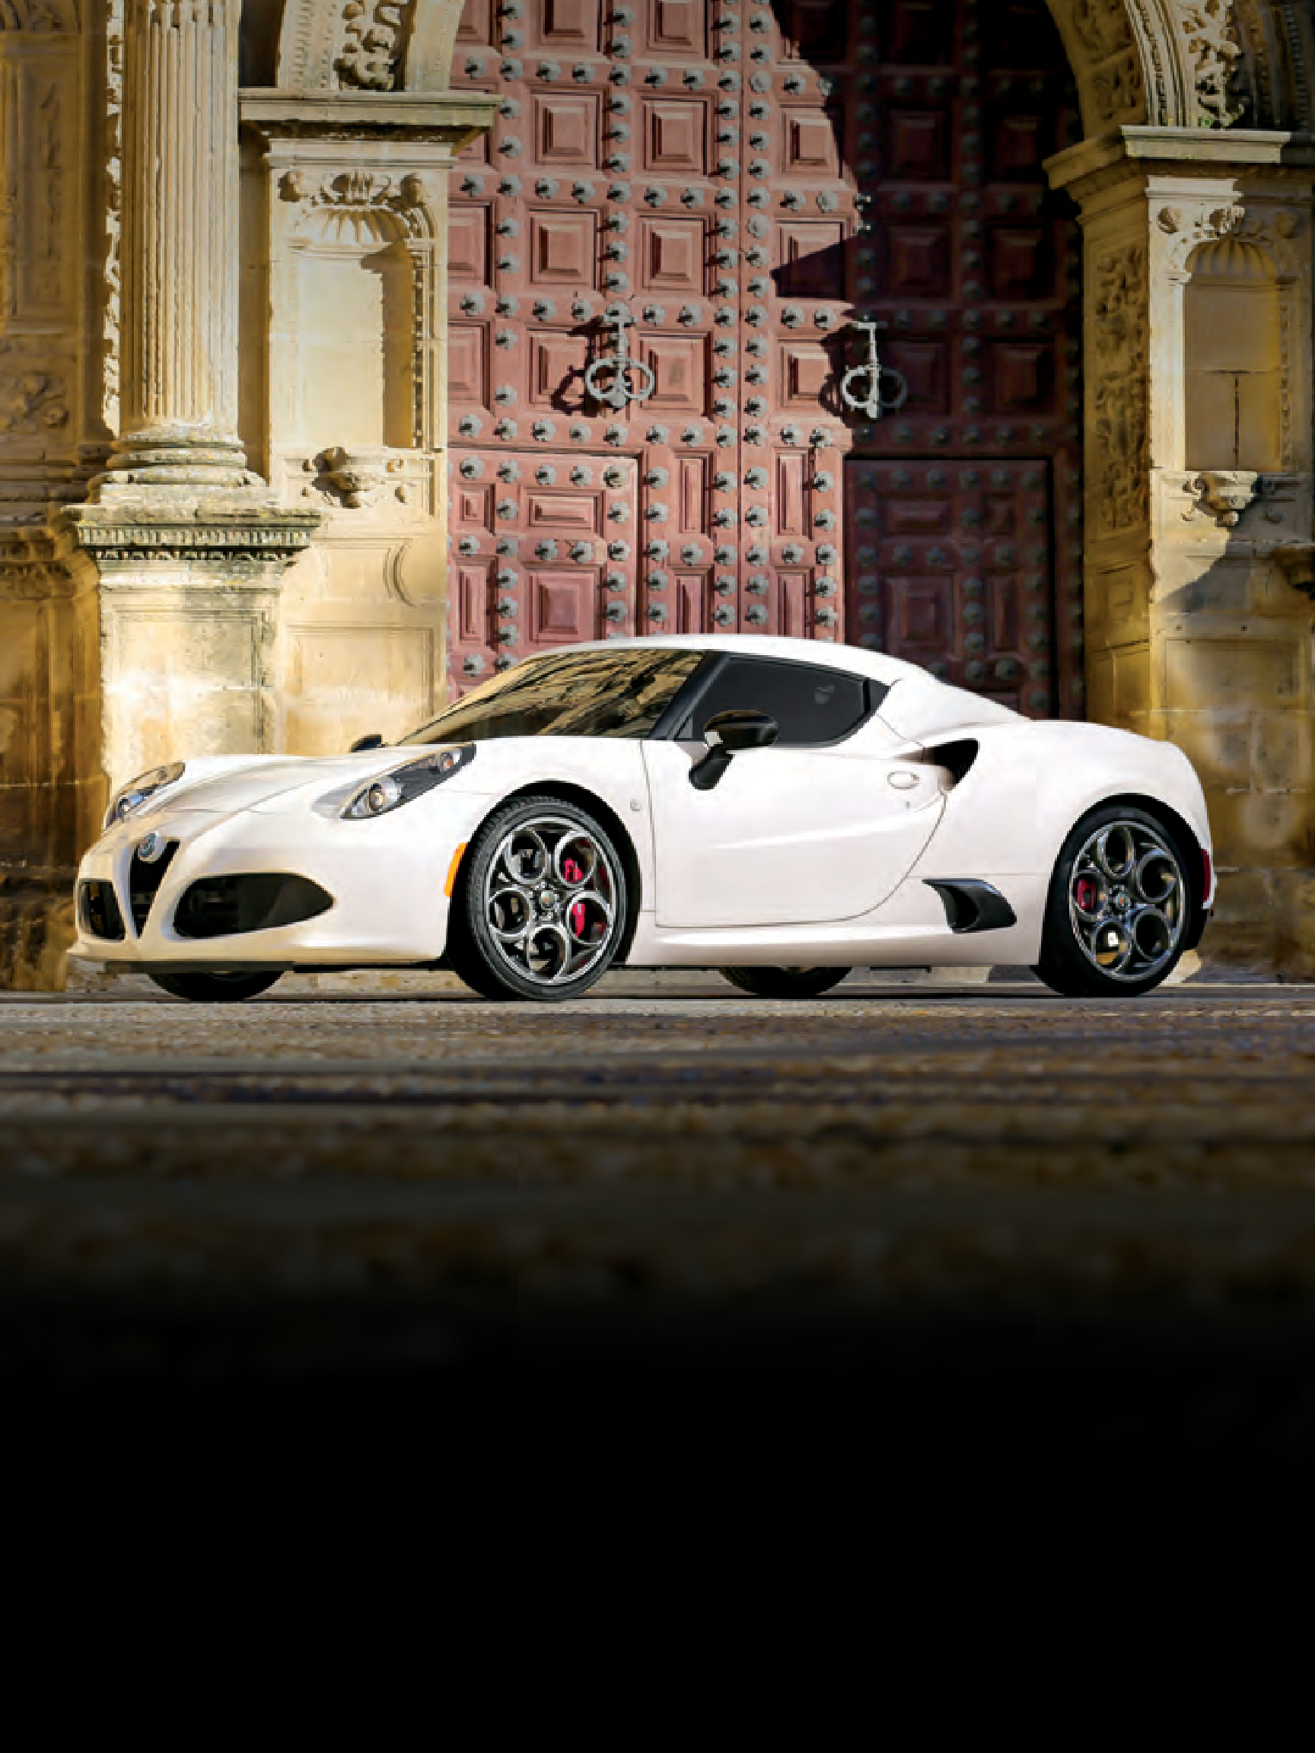
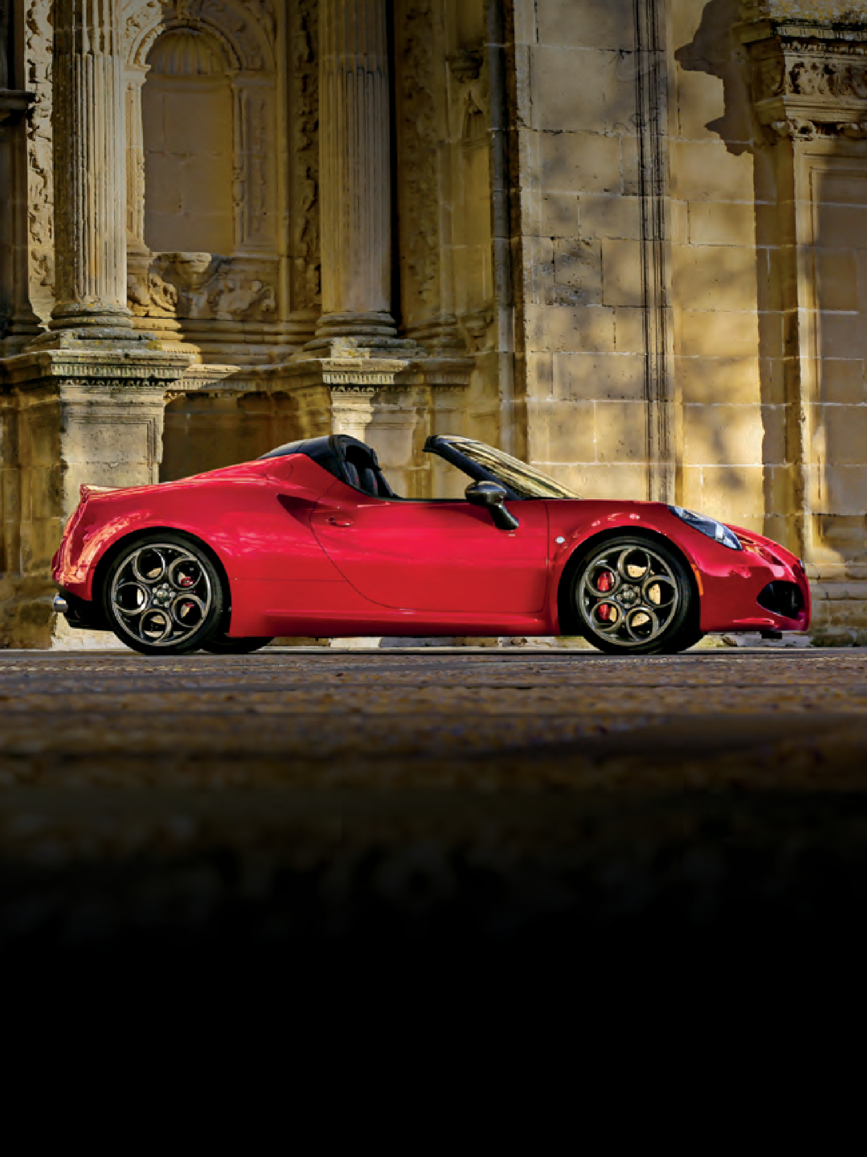
4C COUPE With a captivating mix of progressive technology, race-inspired performance and seductive styling, the Alfa Romeo 4C Coupe thrills Alfa Romeo devotees, performance enthusiasts and car connoisseurs alike. The world’s foremost racing chassis designers collaborated on its highly praised framework. Its carbon fiber monocoque chassis and other advanced lightweight technologies help put 4C performance into supercar territory — and reflect more than a century of Alfa Romeo innovation and racetrack wins. This is supreme performance that can
be experienced first-hand instead of admired from afar.
PASSION RUNS
IN THE FAMILY
4C SPIDER The Alfa Romeo 4C Spider delivers the thrill of the 4C Coupe’s sharp corners and quick turn-ins with open-air exhilaration. Beyond delivering outdoor splendor to its fullest, the open-air design of the 4C Spider turns glances into gazes with gleaming carbon fiber
accents found inside and out. Carbon fiber also contributes to its overall performance:
its rigid but ultralight carbon fiber monocoque chassis, windshield surround and halo are key reasons why its removable soft top adds only minimal weight.
4
INTRODUCTION
5

Slide 4


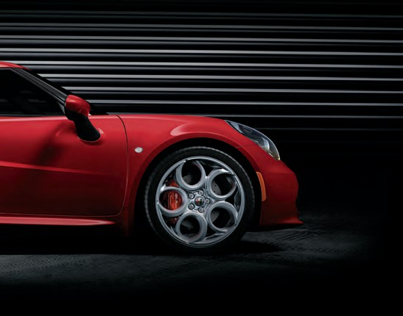
A POWERFUL BACKSTORY
For more than one hundred five years, Alfa Romeo has earned its
high-performance reputation through daring innovation. With a proven record of European and World Championships, those risks proved valuable on both track and street.
1938
The Alfa Romeo 4C unabashedly draws its inspiration from the iconic 1967 Alfa Romeo
33 Stradale, a long-time fixture on “world’s best” car lists. Alfa Romeo produced just 18 examples of the 33 Stradale, the street-legal version of the racing Tipo 33. It was packed with the era’s most innovative technology, including a mixed-structure chassis derived from aeronautical technology. As seen at first glance, the 33 Stradale and the 4C share the same lines, in which every single element has an essential function, and nothing is superfluous. Both convey the pure automotive passion held by every designer, engineer, driver and enthusiast that has influenced
Alfa Romeo — past and present.
1910
1929
1967
1932
“I feel for Alfa the same tenderness one
feels when remembering his first love”. — Enzo Ferrari
iespirugioe: // çgrueuce
1967
2017
6
HISTORY
7

Slide 5
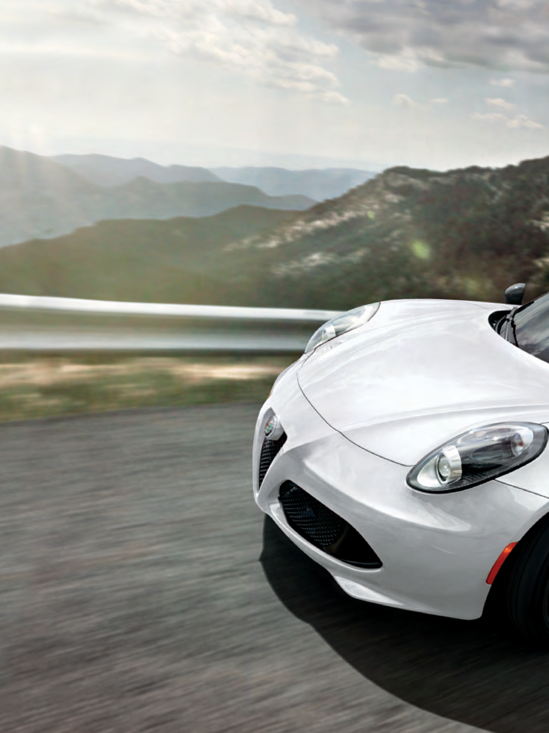
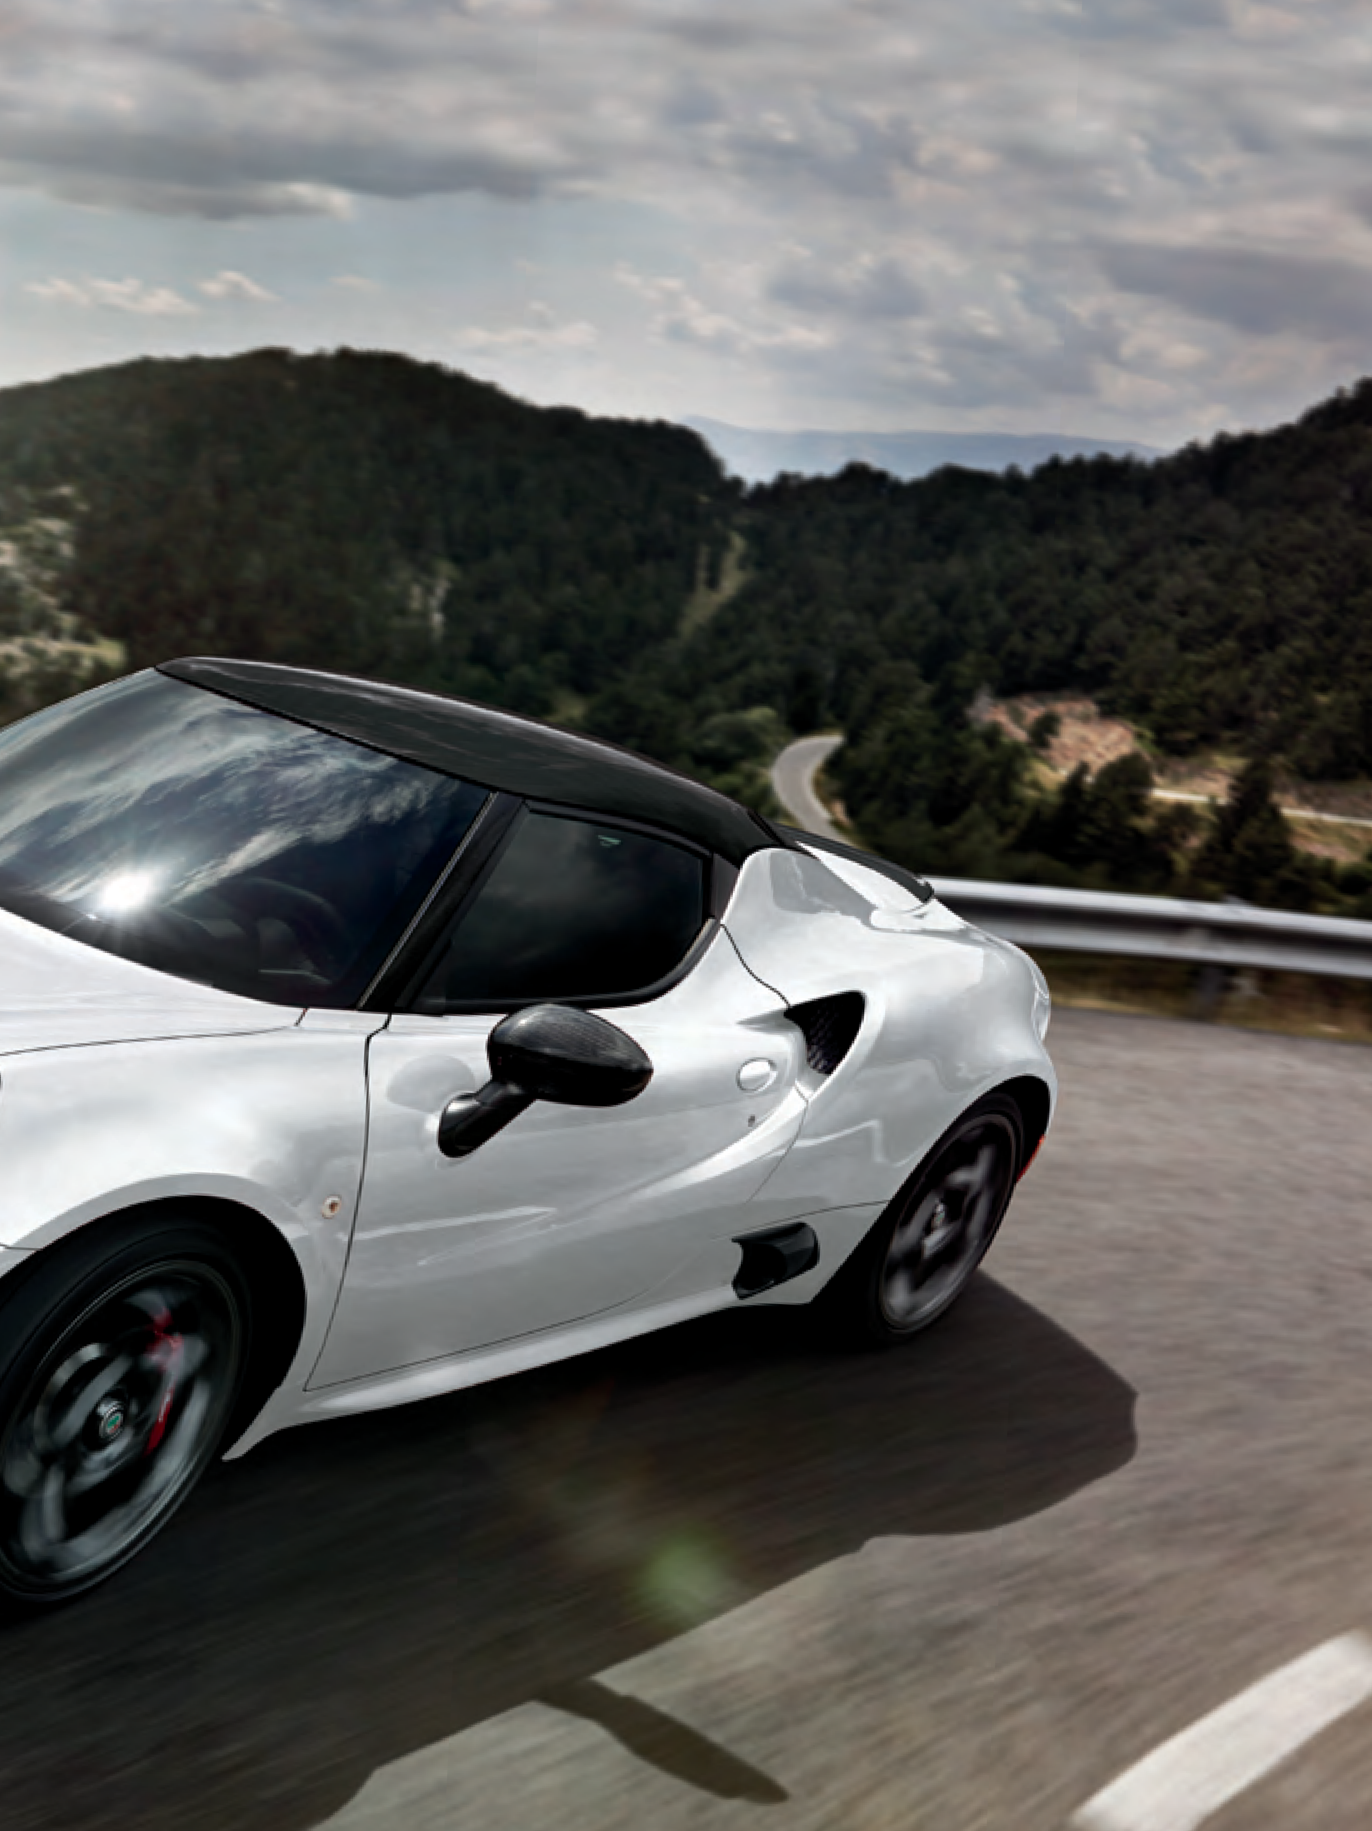
A THRILL FOR ALL SENSES
The Alfa Romeo 4C is all about a pure connection to the road. It’s a purposeful engineering decision made for discerning drivers who are looking for the highest quality feedback. These same purists
recognize the distinctive Alfa Romeo exhaust note with its signature “gargle” at idle and a formidable roar when the throttle is wide open. Its mid-engine design helps create the near-perfect balance that is key to its thrilling performance. Taken all together, these experiences evoke the rich Alfa Romeo racing heritage at every turn.
8
4C COUPE
9

Slide 6
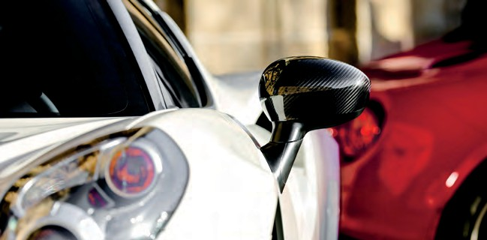
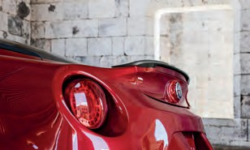
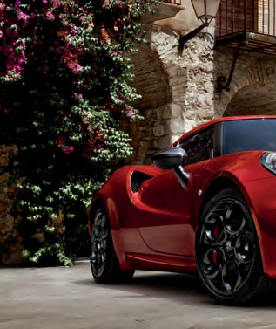
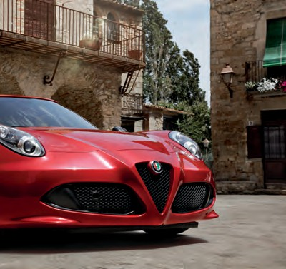
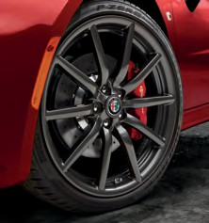
The Alfa Romeo 4C with carbon fiber roof and spoiler. The spoiler is also available in body-color.
Beyond awe-inspiring mechanics and design, the distinctive choices offered by the 4C Coupe turn driving this Alfa Romeo into a personal affair. Absolutely everything expresses the racing spirit of Alfa Romeo — the finely crafted details are
purposeful and carefully curated. Choose from six wheel designs, four caliper colors, available premium leather trim or microfiber seating, body-color or carbon fiber spoiler and mirror covers, and more.
Handcrafted in Modena, Italy, each 4C model features interior and exterior design elements that conspire to win you over, channeling the unique Alfa Romeo spirit. Ultralight and strong, carbon fiber is a key structural component as well as a distinctive embellishment, including the all-new carbon fiber roof, and as shown
above on the mirror cover.
Making a powerful statement of their own, the available 19” dark alloy fan-spoke wheels give you a preview of the thrill ride to come.
10
4C COUPE
11

Slide 7
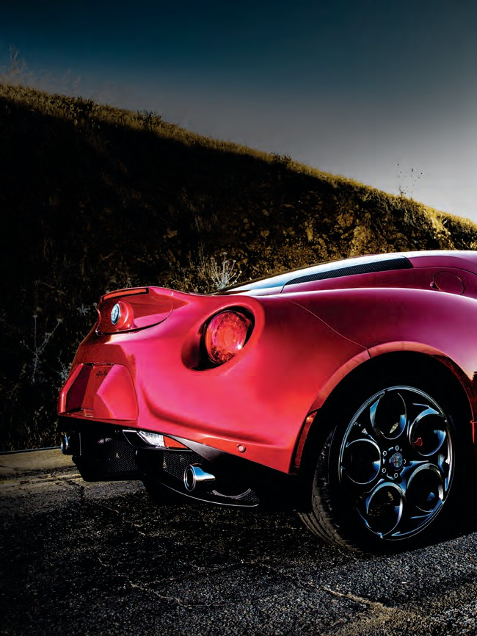
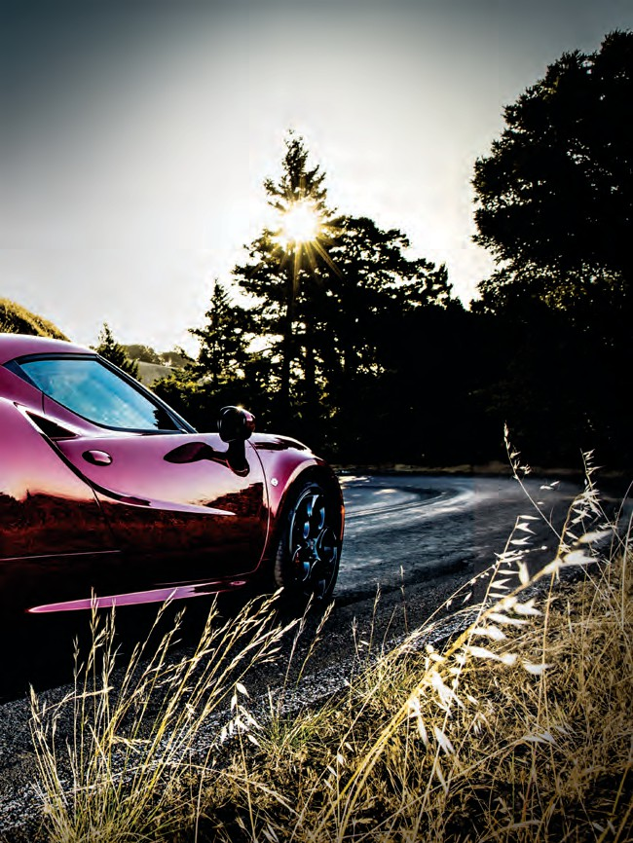
AN EXTRAORDINARY BOND
BETWEEN DRIVER AND ROAD
12
4C COUPE
13

Slide 8
OPEN-AIR EXHILARATION
This is open-air performance like nothing you have experienced. The top-down Alfa Romeo 4C Spider introduces a few more elements to the 4C thrill ride — like wind, sun and some gleaming carbon fiber touches. Thanks to the rigid 4C chassis, few structural modifications were needed to unveil the sky above; a carbon fiber windshield surround and carbon fiber halo complement the ultralight carbon fiber monocoque chassis. The handcrafted monocoque chassis weighs just 236 lb and is three times stronger and seven times lighter than conventional steel. This is what it truly means to go like the wind.
14
4C SPIDER
15

Slide 9
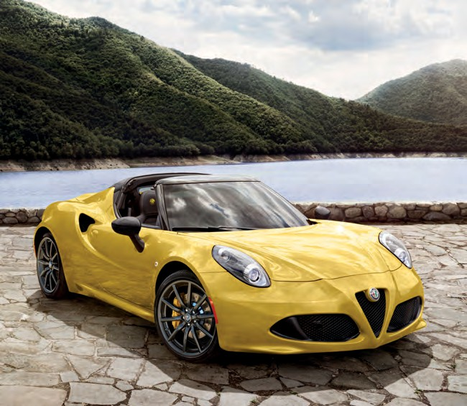
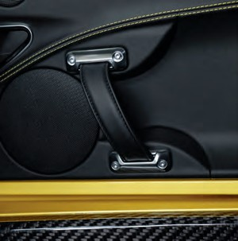
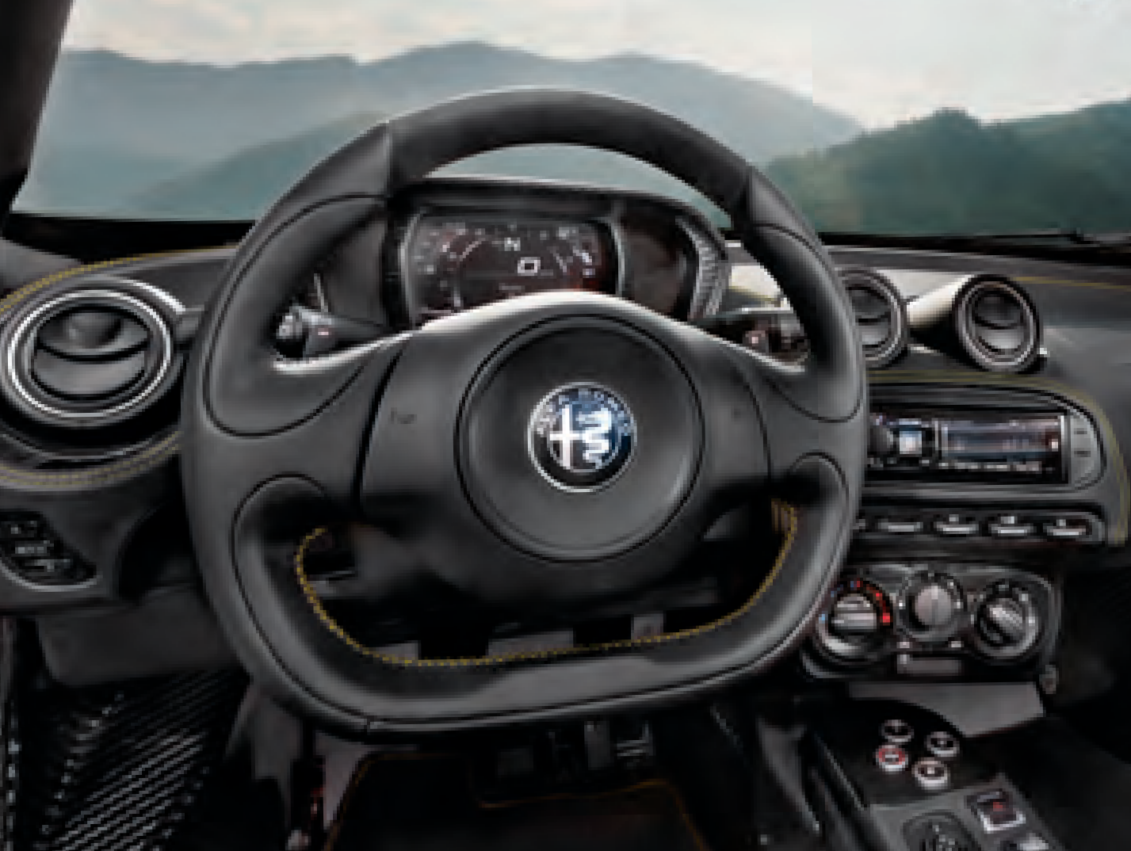
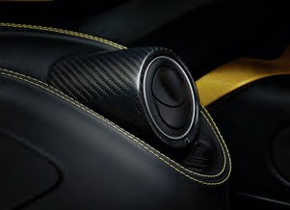
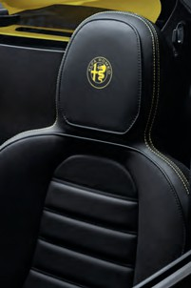
Distinctive interior fabrics and trims feature exterior color-matched contrasting stitching.
The race-inspired steering wheel is flat at the bottom. The instrument panel is made from a thermoformed
shell, like those found on limited-edition supercars.
Personalize your 4C Spider with a choice of seven scene-stealing colors, along with six wheel choices and four brake caliper colors. Rich interior details include a premium leather instrument panel with accent stitching and unique carbon fiber-trimmed vents. Choose from Red, Black, Tobacco leather seats or the available Black leather/microfiber seats, all with accent stitching..
The upholstery, shown in premium leather trim, features pronounced bolstering to keep the driver firmly in place.
16
4C SPIDER
17

Slide 10
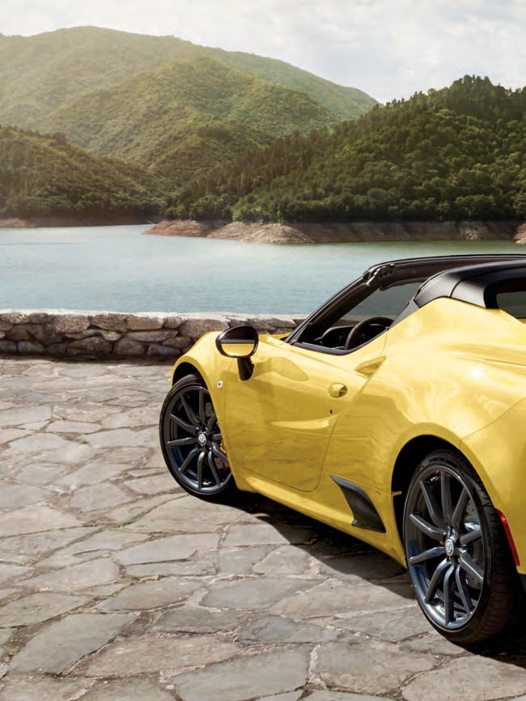

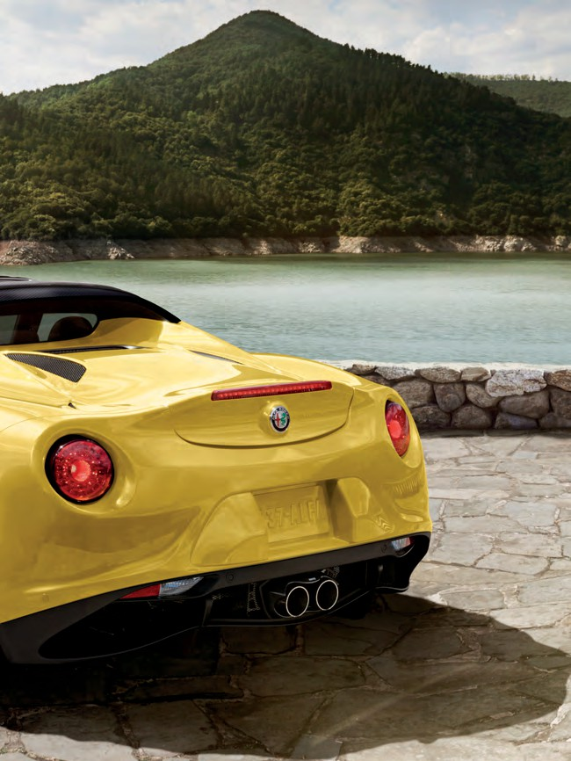
18
4C SPIDER
19

Slide 11


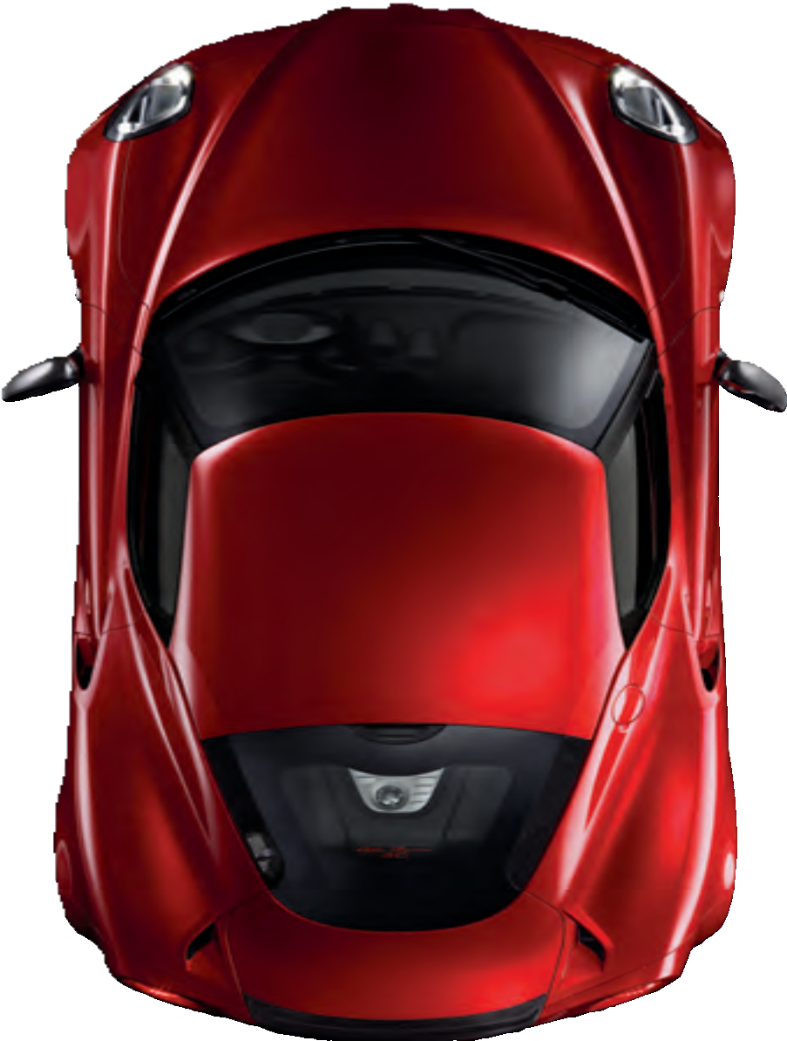


The monocoque chassis of the Alfa Romeo 4C is a single carbon fiber body similar to that of a
supercar, while its crankcase and its front and rear frames combine the strength, rigidity and lightweight properties of aluminum.
REACTIVE ELEMENTS
Natural elements make up the most high-tech materials in automotive engineering — some of the same innovative materials and technology found in supercars and Formula One cars.
The success Alfa Romeo has enjoyed over the years can be attributed to our long dedication to making the most efficient use of both power and weight. This challenge underlies the design of every component of the car. The latest outcome is amazing: a curb weight of under 2,500 lb propelled by
237 hp, giving a weight-to-power ratio of 10.4:1. This is a figure that promises genuine supercar agility and performance. This impressively low weight has been achieved by using ultralight materials like carbon fiber, aluminum and composites, all chosen for maximum dynamic efficiency. Just over 13 feet in length, 6 feet in width and only 46.6 inches in height, the design choices of the 4C are just as bold as its dimensions. It truly is better driving through chemistry.
SUPERCAR
CARBON FIBER MONOCOQUE ALUMINUM SUBFRAMES MID-ENGINE LAYOUT
20
TECHNOLOGY
21

Slide 12

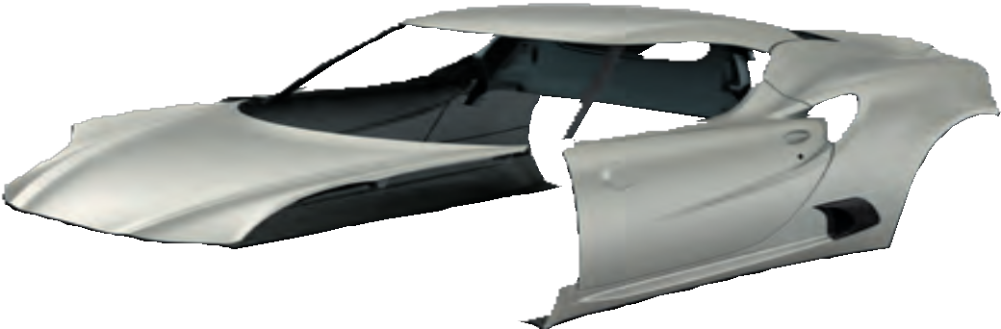

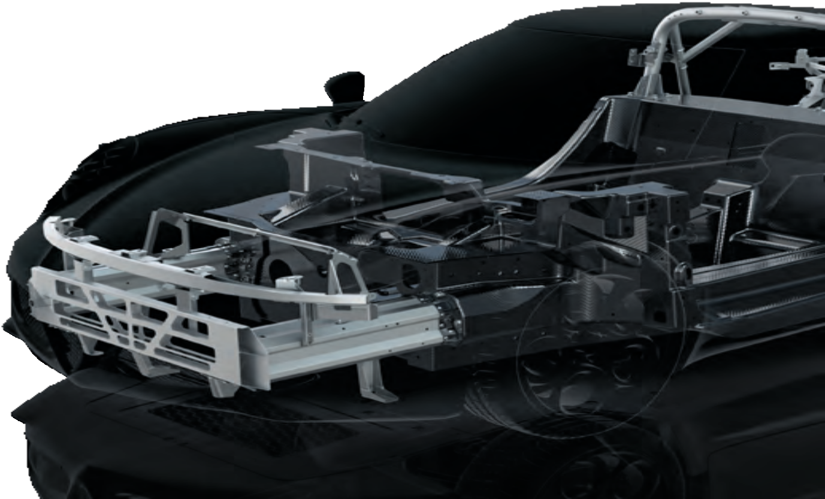
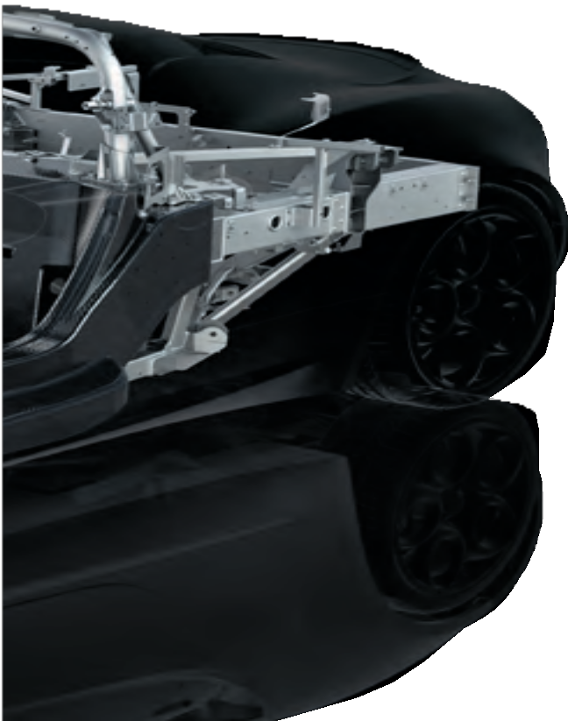


LIGHTWEIGHT STRENGTH
Designed in collaboration with the world’s foremost racing chassis designers,
the Alfa Romeo 4C Coupe and 4C Spider are innovative at their very core.
Supercar DNA runs throughout, including a carbon fiber monocoque chassis, mid-engine design and aluminum subframes.
It begins with the solid foundation of a carbon fiber monocoque chassis. Laid by hand, this carbon fiber is three times stronger and seven times lighter than conventional steel. Front and rear aluminum subframes combine strength with weight-saving technologies. Sheet Molded Compound (SMC) is used for the outer body and is 20% lighter and more stable than steel — and also resists corrosion. The end result of these advanced technologies is incredible strength and remarkable weight-efficiency — the overall curb weight is just under 2,500 lb for both 4C Coupe and 4C Spider.
Composite body shell
aluminum
13
Al
26.982
Aluminum
front sub-frame
carbon
6
C
Aluminum engine frame
12.011
Carbon fiber passenger cell
22
TECHNOLOGY
23

Slide 13
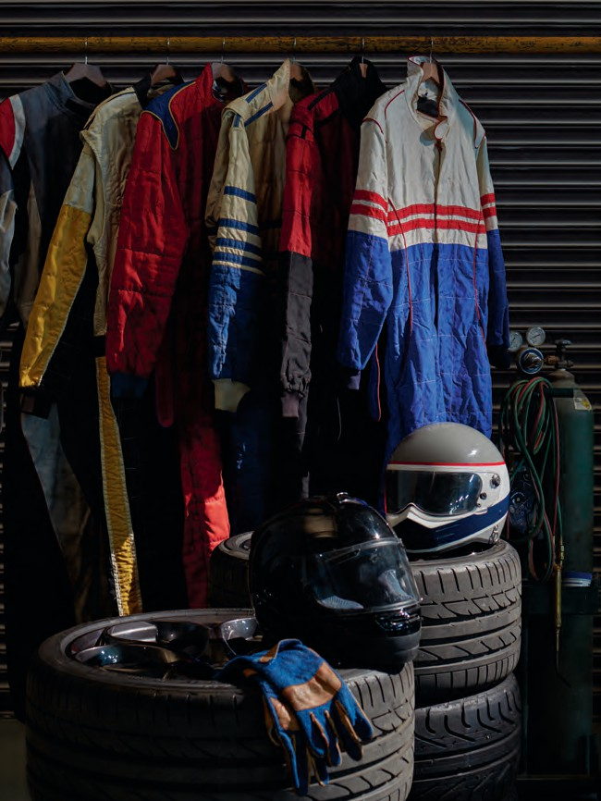
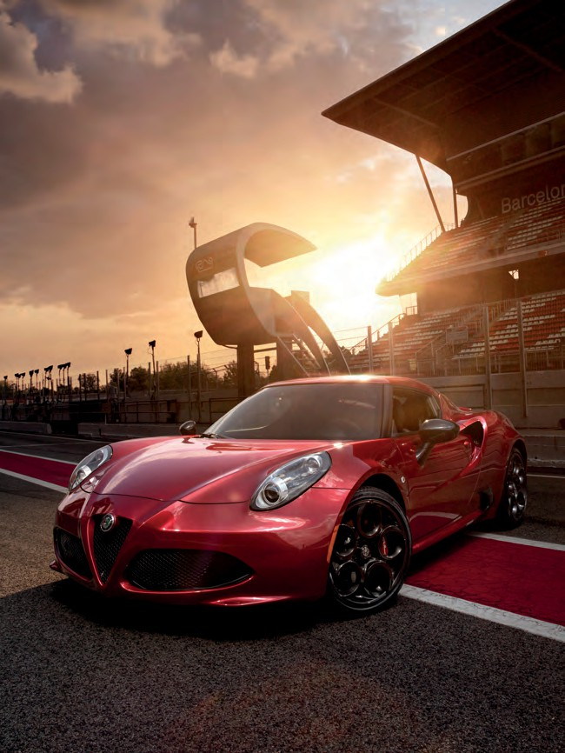
IT’S WHAT HAPPENS
WHEN YOU LET THE SUITS DESIGN A CAR
24
PERFORMANCE
25

Slide 14

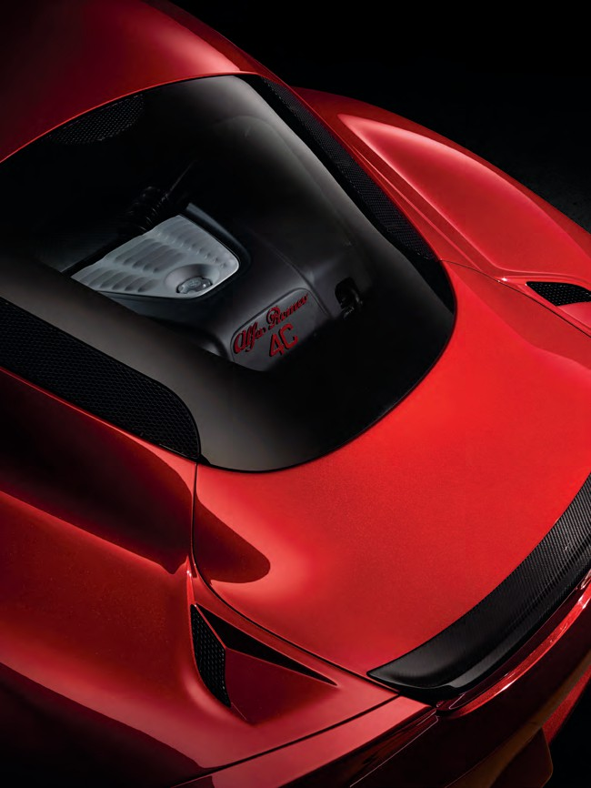

MASTER OF THE POWER AND WEIGHT EQUATION
If there’s one thing Alfa Romeo has learned from years of victory on the racetracks, it’s that balance is key. The mid-engine layout, rear-wheel drive and monocoque chassis give each 4C model ideal weight distribution, with amazing handling and control.
The groundbreaking, centrally mounted aluminum 4C engine significantly reduces weight as it eliminates the need for a
driveshaft and optimizes weight distribution by concentrating mass near the center of the vehicle. With Rear-Wheel Drive (RWD), the 4C makes full use of the dynamic advantages afforded by
this configuration. RWD allows better grip under acceleration when engine power throws weight toward the rear of the car. RWD also lets you enter curves at higher speeds, delivering a far more intense and rewarding driving experience. All of this means the Alfa Romeo 4C will accelerate (0-60 mph in 4.1
seconds) as quickly as cars boasting higher horsepower — yet will corner sharper, brake harder, turn in quicker and respond more readily. It’s the kind of gratifying response that makes
each and every trip something to look forward to.
Horsepower
Torque
peak symmetry
rpm
Torque (N•m) Power (bhp)
26
PERFORMANCE
27

Slide 15
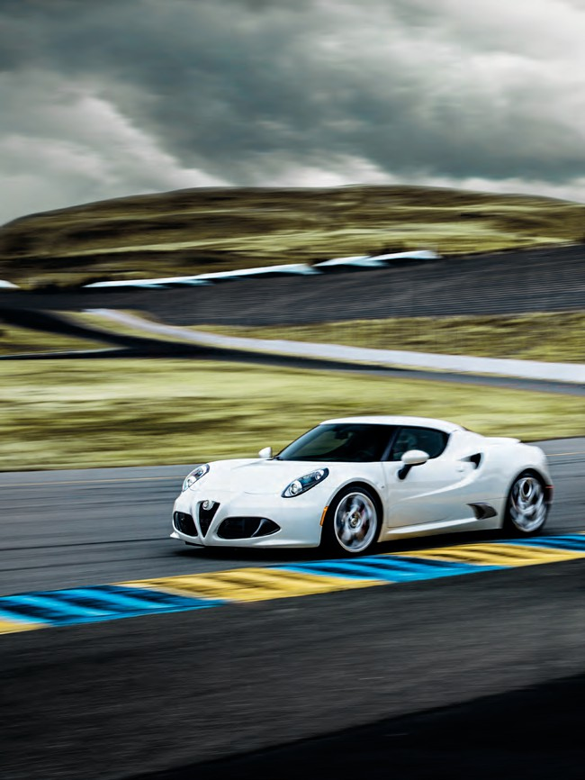
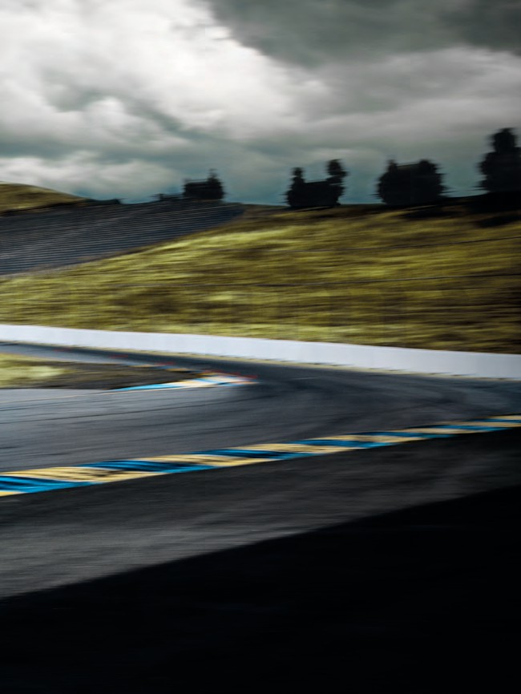

quick response
POINT AND GO
OPTIMIZED AIRFLOW The advanced engine technology of the
Alfa Romeo 4C maximizes torque at low engine speeds and delivers more power in response to driver input. The control unit determines the valve timing to encourage fresh airflow from the intake through to the exhaust during the overlap period. By improving the circulation in the combustion chamber, this direct flow increases combustion efficiency and turbine speed while reducing turbo lag.
TURBOCHARGER The engine is also equipped with a new-generation turbocharger, and a pulse converter exhaust manifold that uses pressure waves to boost torque at low engine speeds. The manifold and turbine are made from microcast steel and designed to operate at very high temperatures (over 1,000°F) — a prerequisite to low fuel consumption on medium/high-speed highway trips. The wastegate valve is another essential device for engine efficiency. This adjusts turbo pressure control logic to suit driving conditions, minimizing pumping losses.
AFTER-RUN PUMP The 4C uses an automatic cool-down system to protect its turbocharger. Switching off the engine would normally cause the immediate stoppage of oil circulation, leaving the oil in the turbocharger to stagnate at very high temperatures. The thermal stress suffered by the oil under these conditions causes a loss of lubricating capacity and also leads to the formation of residues that can damage the engine. To prevent this, Alfa Romeo has introduced an after-run pump. This electric pump is automatically controlled by the Electronic Control Unit (ECU) and keeps oil circulating through the turbocharger until it has cooled sufficiently.
ALFA TWIN CLUTCH TRANSMISSION (TCT) The 4C is equipped with an ALFA TCT 6-speed automatic transmission with a twin clutch and
paddle shifters, a solution that combines the instant power of a sequential shift with all the convenience of an automatic. This system works like two gearboxes in parallel, each with its own clutch, minimizing discontinuity in power transmission. The ALFA TCT clutch has been specially modified for use on the Alfa Romeo 4C, and features control software that ensures the fastest possible gearshifts under all conditions — as quick as 130 milliseconds. Gearshifts are more aggressive in the dynamic and race modes, yet are completed in the
smoothest way possible on bends to avoid reducing stability.
28
PERFORMANCE
29

Slide 16
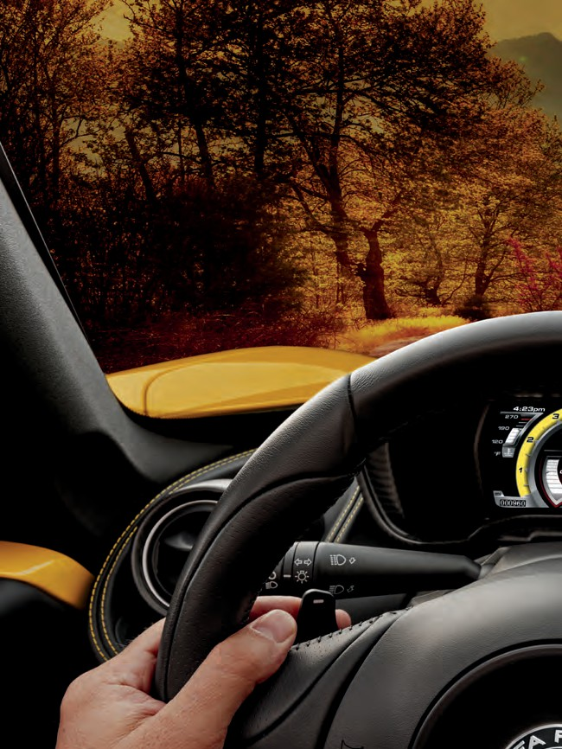

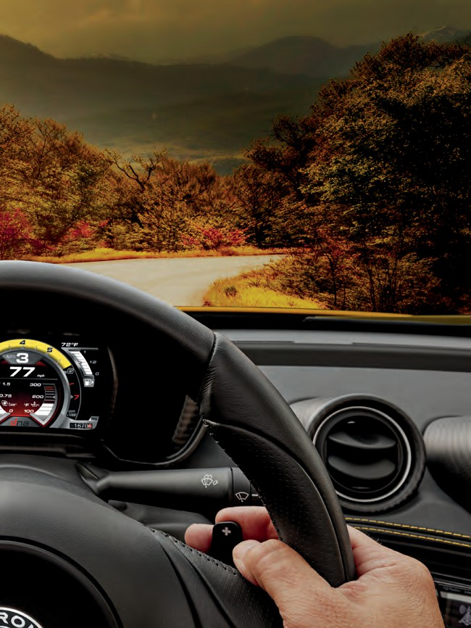

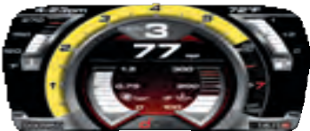

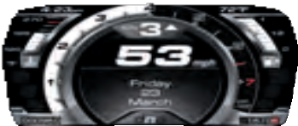




FLAWLESS TRANSITIONS
DYNAMIC True to its name, this mode helps deliver great driving performance with near-instant accelerator response and reduced gearshift times of up to 25%. The ESC¹ system only intervenes when drift angles put the car at risk.
Overall performance is superbly enhanced with numerous features designed to hone and improve each trip. The four-mode Alfa DNA Drive Mode Selector gives drivers the ability to create a customized vehicle experience according to driving conditions or desired vehicle responsiveness. Choose from its All-Weather, Natural, Dynamic or Race settings, which make changes in throttle response, shifting speeds and traction control for a driving experience tailored to any situation.
NATURAL Designed for everyday use, its gearshift parameters are configured for maximum comfort and smoothness. In Manual mode, Auto-Up and Auto-Down functions shift at just the right engine speed. The Alfa Romeo Electronic Q2 differential only cuts in during a significant loss of grip.
RACE This is the most extreme performance mode for 4C. By minimizing the interventions of electronic systems, it leaves the driver in complete command. Electronic Stability Control (ESC)¹ * only intervenes during aggressive braking. Anti-Slip Regulation (ASR) is deactivated under acceleration and braking, while the Alfa Romeo Electronic Q2 differential control system remains active for fast exits from bends.
ALL-WEATHER This mode ensures maximum safety under adverse weather conditions with gentle accelerator response. The ASR system prevents skidding by modifying power to match road speed during loss of grip.
The 4C is also fitted with Launch Control for masterful, high-performance standing starts. Launch Control is activated by pressing the brake pedal while pushing the accelerator pedal all the way down and squeezing the paddle on the left of the steering wheel. As soon as you release the brake, the system automatically controls the transmission, traction and power to maximize acceleration.
30
PERFORMANCE
*All disclaimers and disclosures can be found on page 49.
31

Slide 17
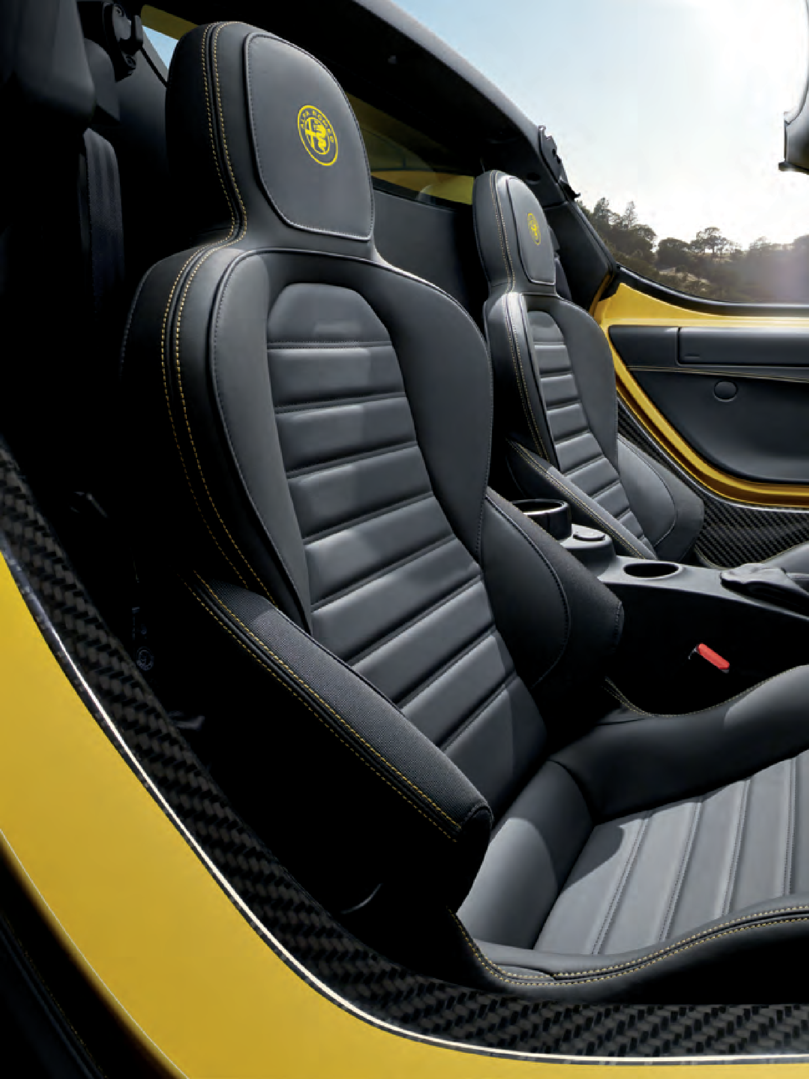
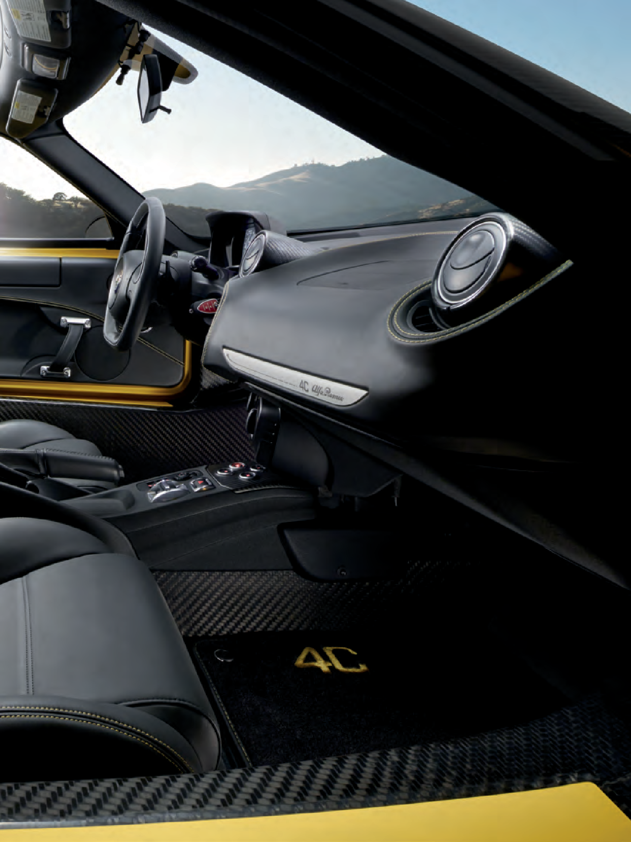
32
PERFORMANCE
33

Slide 18
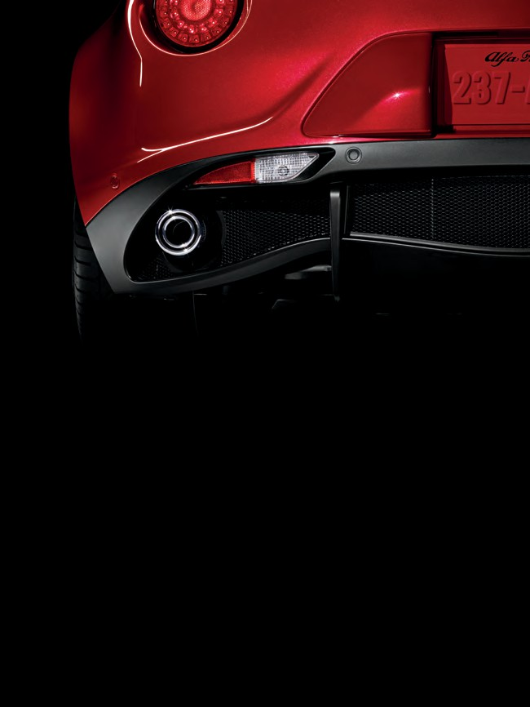
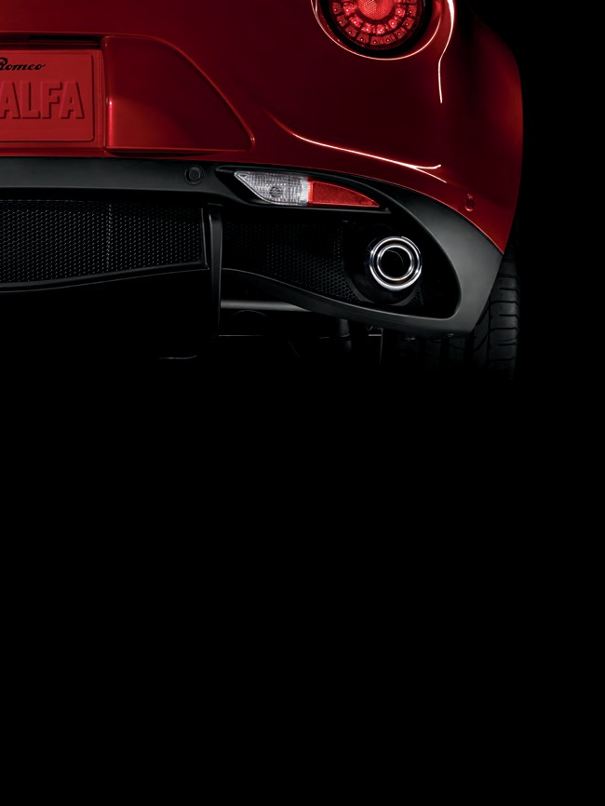
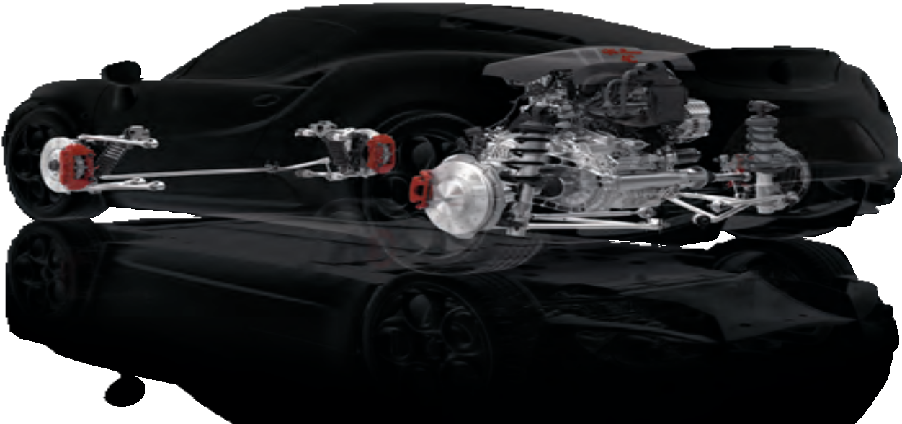
stopping power
A combination of sport suspensions, large self-ventilated cross-drilled brake discs and different-diameter tires: the 4C boasts an advanced ride control system, giving every driver extra street smarts.
The suspension adopts race-derived technical solutions to optimize performance and deliver unrivaled driving pleasure. At the front, the Alfa Romeo 4C features a double-wishbone
configuration that gives direct and unfiltered feedback from the road. At the rear, the advanced MacPherson suspension ensures superb road-holding and driving fun, even in the most extreme maneuvers. Both front- and rear-suspension systems are made from aluminum and high-strength steel. The braking system is designed for high-performance racetrack use. The perforated, self-ventilated front discs and Brembo® calipers offer supreme stopping power. And to ensure maximum grip and prevent skidding under all conditions, the 4C is fitted with different-diameter tires, 17"– 18" or 18" – 19," with the larger size on the rear for the best possible handling.
Perforated, cross-drilled, self-ventilated
discs, 12 x 1.10 in
MacPherson rear suspension
BRILLIANT CONTROL
Perforated, cross-drilled, self-ventilated
discs, 11.5 x 0.87 in
34
PERFORMANCE
35

Slide 19
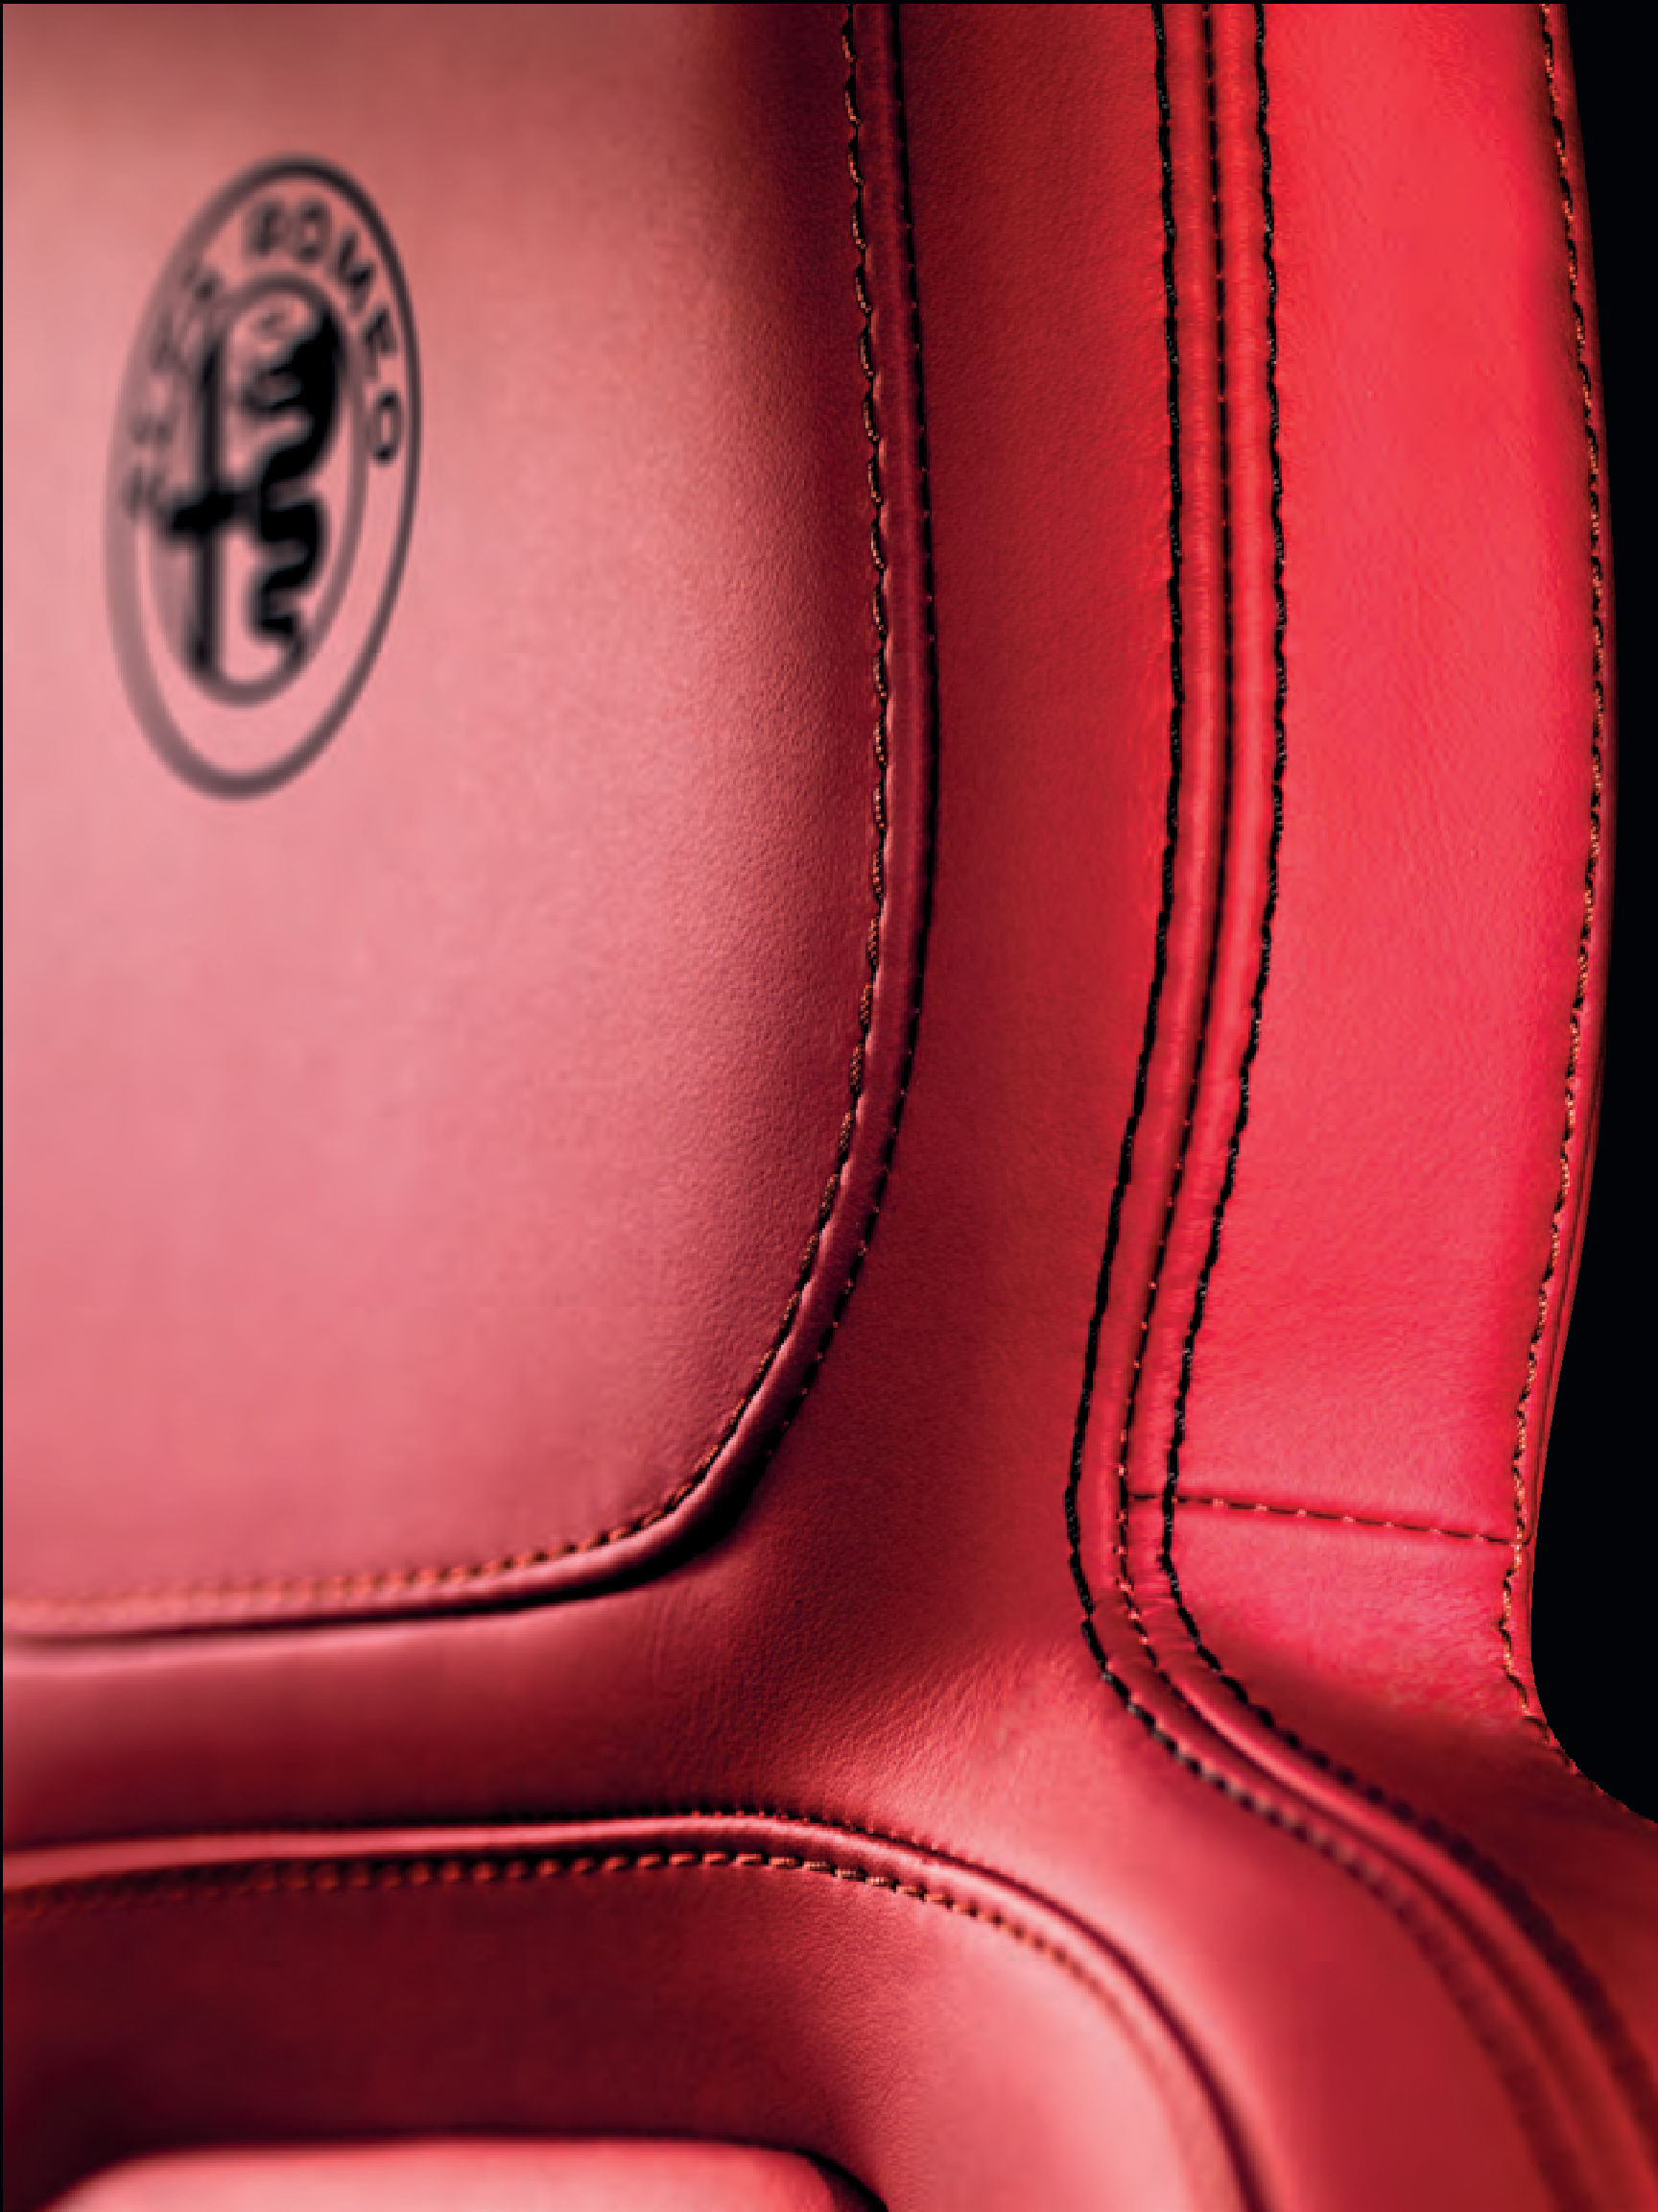

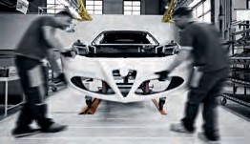
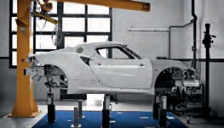

HANDCRAFTED IN ITALY
In almost every aspect of the Alfa Romeo 4C, you can sense the touch of fine hand craftsmanship in each vehicle assembled in the Maserati workshop located in Modena, Italy. Impeccable standards and extensive inspections ensure utmost satisfaction.
Here, the focus is always on evolved technology and top-quality craftsmanship, a combination that leads to the production of cars that are unique in technical solutions and attention to detail. No surprise that the build time for each Alfa Romeo 4C is a full six weeks. At the 4C workshop, people make the difference.
The expert technicians dedicated to the production of this Alfa Romeo have each undergone 500 hours of special training. They all have an enviable level of in-depth technical knowledge as a result. Assembly technicians follow every phase of the process personally and, at the end of the line, perform rigorous quality control tests to ensure that all components function perfectly.
The finished car is then handed over to expert test drivers for dynamic performance testing under a wide range of conditions. Only then is a new Alfa Romeo 4C declared ready to take to the road.
36
STYLING
37

Slide 20
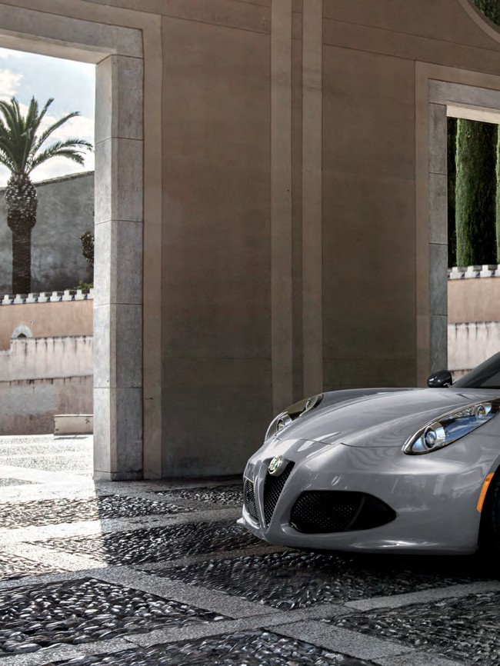

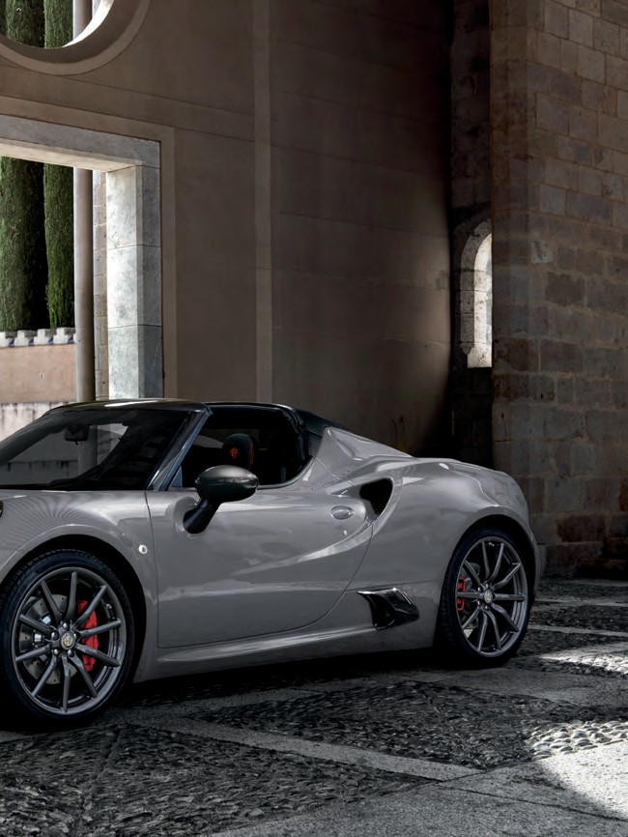
a culture of style
BUILT- IN CHARISMA
Perhaps it’s no coincidence that Alfa Romeo was born in Milan, Italy — the fashion capital of the world. It’s a place that understands that the heart must have a say in even the most practical decisions.
The Alfa Romeo 4C Coupe and 4C Spider continue an Alfa Romeo tradition of performance-oriented lines and proportions. Inspired by the 1967 Tipo 33 Stradale, considered by many to be one of the most beautiful cars ever made, the 4C models are just as shapely, and offer the classic Alfa Romeo V-shaped trilobe “plunging neckline” front grille. Front and rear overhangs are dramatically short, and dimensions are aerodynamically and dynamically optimized. The famous Alfa Romeo badge confirms what all these visual cues are saying: this is a legitimate sports car.
38
STYLING
39

Slide 21
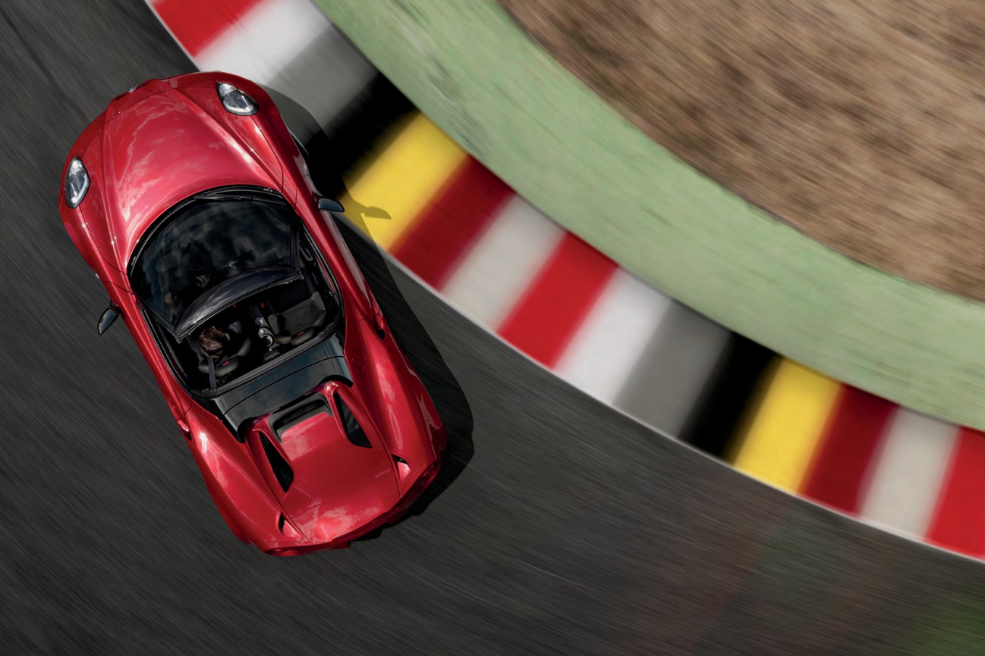
CROSSING THE BOUNDARIES OF EXPEC TED HUES
Rosso Alfa
White
Basalt Gray
Black
Giallo Prototipo
Rosso Competizione
Madreperla White
40
COLOR PALETTE
41

Slide 22
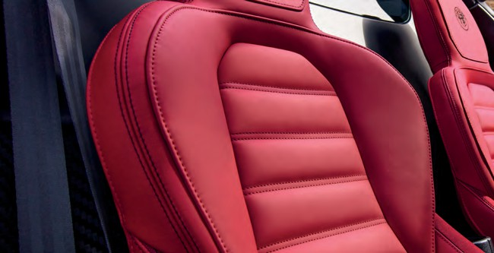
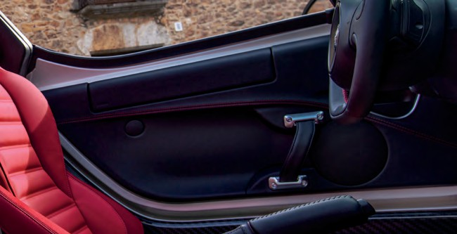







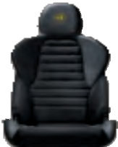





4C SPIDER INTERIOR/EXTERIOR COMBINATIONS
4C COUPE INTERIOR/EXTERIOR COMBINATIONS
A
Black leather trim with Red accent stitching
B
Black leather trim
with Yellow accent stitching
C
Black/Tobacco leather trim with Dark Brown accent stitching
G
Black fabric with Red accent stitching
H
Black leather trim with Red accent stitching
I
Black leather trim with Yellow accent stitching
D | E | F | J | K | L | M
Black leather and microfiber | Black leather and microfiber | Red leather trim | Black leather and microfiber | Black leather and microfiber | Black/Tobacco leather trim with | Red leather trim with
with Red accent stitching | with Yellow accent stitching | with Black accent stitching | with Red accent stitching | with Yellow accent stitching | Dark Brown accent stitching | Black accent stitching
 | A | B | C | D | E | F
PAINT COLOR
Black | • | – | ° | ° | – | °
White | • | – | ° | ° | – | °
Rosso Alfa | • | – | ° | ° | – | °
Giallo Prototipo | – | • | – | – | ° | –
METALLIC
Basalt Gray | • | – | ° | ° | – | °
TRI-COAT PAINT
Madreperla White | • | – | ° | ° | – | °
Rosso Competizione | • | – | ° | ° | – | –
 | G | H | I | J | K | L | M
PAINT COLOR
Black | • | ° | – | ° | – | ° | °
White | • | ° | – | ° | – | ° | °
Rosso Alfa | • | ° | – | ° | – | ° | °
Giallo Prototipo | – | – | ° | – | ° | – | –
METALLIC
Basalt Gray | • | ° | – | ° | – | ° | °
TRI-COAT PAINT
Madreperla White | • | ° | – | ° | – | ° | °
Rosso Competizione | • | ° | – | ° | – | ° | –
Standard •
Optional °
Not available –
Standard • Optional ° Not available –
42
INTERIOR OPTIONS
43

Slide 23
















17" – 18" light alloy wheels
17"– 18" dark alloy wheels
18" – 19" Silver 5-hole alloy wheels
17" – 18" alloy wheels
17" – 18" alloy wheels with Matte Black diamond finish
18" – 19" Silver 5-hole alloy wheels
4C SPIDER WHEELS
4C COUPE WHEELS
18" – 19" dark 5-hole alloy wheels
18" – 19" light alloy fan-spoke wheels
18" – 19" dark alloy fan-spoke wheels
18" – 19" dark 5-hole alloy wheels
18" – 19" light alloy fan-spoke wheels
18" – 19" dark alloy fan-spoke wheels
4C CALIPER COLOR OPTIONS
Silver brake calipers
Yellow brake calipers
Red brake calipers
Black brake calipers
44
WHEEL OPTIONS
45

Slide 24






EQUIPMENT
 | 4C COUPE | 4C SPIDER
EXTERIOR EQUIPMENT
17" – 18" alloy wheels | • | •
17" – 18" alloy wheels with Matte Black diamond finish | ° | –
17" – 18" dark alloy wheels | – | °
18" – 19" Silver 5-hole alloy wheels | ° | °
18" – 19" dark 5-hole alloy wheels | ° | °
18" – 19" Silver alloy fan-spoke wheels | ° | °
18" – 19" dark alloy fan-spoke wheels | ° | °
205/45R17 and 235/40R18 Pirelli® PZero AR Three-Season tires — Included with 17" – 18" alloy wheels with Matte Black diamond finish* on Coupe and 17" – 18"dark alloy wheels† on Spider | •/ | •/
205/40R18 and 235/35R19 Pirelli PZero AR Three-Season tires — Included with 18" – 19" dark 5-hole alloy wheels, 18" – 19" Silver 5-hole alloy wheels, 18" – 19" Silver alloy fan-spoke wheels and 18” – 19” dark alloy fan-spoke wheels
205/40R18 and 235/35R19 Pirelli PZero Performance AR Racing tires — Requires Coupe Track Package 1/2 or Spider Track Package 3/4 | ° | °
Silver brake calipers | • | •
Black brake calipers | ° | °
Yellow brake calipers | ° | °
Red brake calipers | ° | °
Sport-tuned exhaust with double-exhaust tail pipe and chrome tips | ° | °
Akrapovič dual-mode exhaust system featuring dual, center-mounted tips with carbon fiber surround | ° | °
Rear parking sensors (included with Convenience Group)
Carbon fiber roof | ° | –
Carbon fiber halo | – | °
Carbon fiber spoiler (included with Coupe Track Package 1/2) |  | –
Spoiler in body-color | ° | –
Body-color mirrors | • | •
Satin Titanium-finish mirrors | ° | °
Carbon fiber mirror covers (requires Coupe Track Package 1/2 or Spider Track Package 3/4)
Carbon fiber mirrors with Italian flag inlay (requires Coupe Track Package 1/2 or Spider Track Package 3/4) | °/ | °/
Manual folding, power heated exterior mirrors | • | •
LIGHTING SYSTEM
LED taillamps | • | •
Halogen projector headlamps | • | •
Bi-xenon projector headlamps | ° | °
PERFORMANCE
Normal-duty suspension | • | •
Racing suspension with unique front and rear sway bars and performance-tuned shock absorber (included with Coupe Track Package 1/2 and Spider Track Package 3/4)
SAFETY
Electronic Stability Control (ESC)¹ with Electronic Q2 | • | •
ABS, traction control, Brake Assist, daytime running lamps (DRLs), Hill Start Assist | • | •
Driver and front-passenger air bags,² driver’s-side knee air bag,² door-mounted side thorax air bags² | • | •
Tire Pressure Monitoring System | • | •
Tire Service Kit | • | •
Engine immobilizer | • | •
PACKAGES
Convenience Group — Includes cruise control, vehicle security alarm, ParkSense® Rear Park Assist³ | ° | °
Carbon Fiber Interior Trim Group — Includes carbon fiber instrument panel bezel, shift bezel, air vents and cluster bezel | ° | °
Akrapovič dual-mode center-mounted exhaust with carbon fiber surround
Satin Titanium-finish mirrors
Body-color spoiler
Bi-xenon projector headlamps
*Not available on 4C Spider. †Not available on 4C Coupe.
Standard • Optional ° Package
Not available –
Carbon fiber mirror
Carbon fiber spoiler
46
4C FEATURES AND OPTIONS
47

Slide 25





EQUIPMENT (CONTINUED)
 | 4C COUPE | 4C SPIDER
PACKAGES (CONTINUED)
Coupe Track Package 1— Includes carbon fiber rear spoiler, carbon fiber exterior mirrors or carbon fiber mirror with Italian flag inlay, performance flat-bottom steering wheel wrapped with Black leather and microfiber with accent stitching and race-tuned suspension | ° | –
Coupe Track Package 2 — Includes carbon fiber rear spoiler, carbon fiber exterior mirrors or carbon fiber mirror with Italian flag inlay, and race-tuned suspension | ° | –
Spider Track Package 3 — Includes performance flat-bottom steering wheel wrapped with Black leather and microfiber with accent stitching and race-tuned suspension | – | °
Spider Track Package 4 — Includes race-tuned suspension | – | °
INTERIOR EQUIPMENT
Height- and reach-adjustable steering wheel in leather | • | •
Height- and reach-adjustable steering wheel in leather and microfiber — Included in Coupe Track Package 1 or Spider Track Package 3
Paddle gearshift controls | • | •
Cruise control (included with Convenience Group)
Sport seats in Black fabric with accent stitching | • | –
Sport seats in Black leather trim with accent stitching | ° | •
Sport seats in Red leather trim with accent stitching | ° | °
Sport seats in Black/Tobacco leather trim with accent stitching | ° | °
Sport seats in mixed leather and microfiber fabric with accent stitching | ° | °
Aluminum pedals and footrest | • | •
Aluminum passenger footrest | • | •
Carpet kit with embroidered logo | • | •
Cup-holder insert | • | •
ELECTRICAL SYSTEM
Remote keyless entry | • | •
Power windows | • | •
12-volt power outlet | • | •
AM/FM radio with iPod® control, USB and SD card connectivity, Bluetooth® for hands-free calling⁴ and music streaming | • | •
Premium speaker package | • | •
Alpine® Premium Audio System with subwoofer | ° | °
INSTRUMENTATION
4-position, Alfa DNA Drive Mode Selector | • | •
Full-digital 7.0-inch instrument cluster with TFT instrument cluster display | • | •
Air conditioning system | • | •
ACCESSORIES
Red car cover with Alfa Romeo 4C logo | ° | °
Battery charger | ° | °
Car Care Kit | ° | °
Sport steering wheel in leather with microfiber insert and Red stitching
Red leather-trimmed bucket seats
Full-digital instrument cluster with Thin Film Transistor (TFT) display and carbon fiber cluster surround
Four-position, Alfa DNA Drive Mode Selector
Standard •
Optional ° Package Not available –
1. No system, no matter how sophisticated, can repeal the laws of physics or overcome careless driving actions. Performance is limited by available traction, which snow, ice and other conditions can affect. When the ESC warning lamp flashes, the driver needs to use less throttle and adapt speed and driving behavior to prevailing road conditions. Always drive carefully, consistent with conditions. Always wear your seat belt. 2. Certified to federal regulations that allow less forceful air bags. Always wear seat belts. Rearward-facing child seats should never be used in front of an air bag. 3. Always look before proceeding, electronic drive aid is not a substitute for conscientious driving; always be aware of your surroundings. 4. Requires a mobile phone equipped with the Bluetooth Hands-Free Profile.
©2016 FCA US LLC. All Rights Reserved. Alfa Romeo, Alfa Romeo 4C and Maserati are registered trademarks of FCA Group Marketing S.p.A., used with permission. ParkSense is a registered trademark of FCA US LLC.
Alpine and the Alpine logo are registered trademarks of Alpine Electronics, Inc. All Rights Reserved. Bluetooth is a registered trademark of Bluetooth SIG, Inc. Brembo is a registered trademark of Freni Brembo S.p.A. Facebook and logo are registered trademarks of Facebook, Inc. Instagram is a registered trademark of Instagram, Inc. iPad, iPhone, iPod and iTunes are registered trademarks of Apple Inc. All rights reserved. Pirelli is a registered trademark of Pirelli Tyre S.p.A. The Twitter logo is a service mark of Twitter, Inc.
About this catalog: since the time of printing, some of the information you’ll find in this catalog may have been updated. Ask your dealer for details. Some of the equipment shown or described throughout this catalog may be available at extra cost. Specifications, descriptions, illustrative materials and all competitive comparisons contained herein are as accurate as known at the time this publication was approved for printing. FCA US LLC reserves the right to discontinue models at any time or change specifications without notice or without incurring obligation. Some options may be required in combination with other options. For the price of the model with the equipment you desire, or verification of specifications contained here, see your Alfa Romeo dealer.
Red car cover with Alfa Romeo 4C logo
48
4C FEATURES AND OPTIONS
49

Slide 26




TECHNICAL SPECIFICATIONS
ENGINE
Type | 1750 turbocharged, aluminum, 4-cylinder
Position | Mid-engine
Orientation | Transverse
Displacement (cc) | 1742 cc
Maximum power (hp at rpm) | 237 hp @ 6,000 rpm
Maximum torque (lb-ft at rpm) | 258 lb-ft between 2,200 – 4,250 rpm
DRIVING-MODE SELECTOR
Type | Alfa DNA
Positions | All-Weather, Natural, Dynamic, Alfa Race
TRANSMISSION
Gearbox | ALFA TCT with dual dry clutch, paddle controls and Launch Control
Number of gears | 6 + R
Drive | Rear
Differential | Electronic Q2
CHASSIS
Type | Genuine carbon fiber monocoque
Front suspension | Double-wishbone
Rear suspension | MacPherson
Front brakes (mm) | Dual-cast, cross-drilled, self-ventilated 305 x 28 discs Brembo® fixed 4-piston calipers
Rear brakes (mm) | Cross-drilled, self-ventilated 292 x 22 discs
Standard front tires | 205/45 R17 88Y XL Three-Season Performance
Standard rear tires | 235/40 R18 95Y XL Three-Season Performance
STEERING
Steering box | Rack and pinion
PERFORMANCE
Acceleration 0 – 60 mph (secs) | 4.1
Top speed (mph) | 160
Maximum deceleration under braking (g) | 1.25
Maximum lateral acceleration (g) | 1.1
CAPACITIES — WEIGHTS
Curb weight (EPA) (lb) | 2,465 4C Coupe 2,487 4C Spider
Fuel tank (gal) | 10.5
FUEL ECONOMY
EPA est. city/hwy/combined (mpg)* | 24 / 34 / 28
DIMENSIONS
Number of seats | 2
Length (inches) | 157
Width (inches) | 73.5
Height (inches) | 46.6 4C Coupe 46.7 4C Spider
Wheelbase (inches) | 93.7
Luggage compartment capacity (cu ft) | 3.7
ALFA TCT gearbox with dual dry clutch, paddle controls and Launch Control
1750 turbocharged, aluminum, 4-cylinder engine
Dual-cast, cross-drilled, self-ventilated, 305- x 28-mm front discs with Brembo® fixed 4-piston calipers
*Based on 2016 EPA estimated ratings. Actual mileage may vary.
Genuine carbon fiber monocoque chassis
50
4C FEATURES AND OPTIONS
51

Slide 27







ALFA ROMEO MERCHANDISE
Bring legendary Alfa Romeo distinction to your personal lifestyle with sumptuous leather and carbon fiber accessories. The Alfa Romeo logo adorns an exclusive selection of professional, active, travel and home accessories, as well as apparel and gift cards for your favorite Alfa Romeo enthusiast. Shop the complete collection at shopalfaromeousa.com
52
MERCHANDISE
53

Slide 28



@alfaromeousa
54
SOCIAL MEDIA
55

